Slide 1
Social Media For Large Agencies
Jamie Klenetsky Fay
Digital Media Manager, Morris County

Slide 2
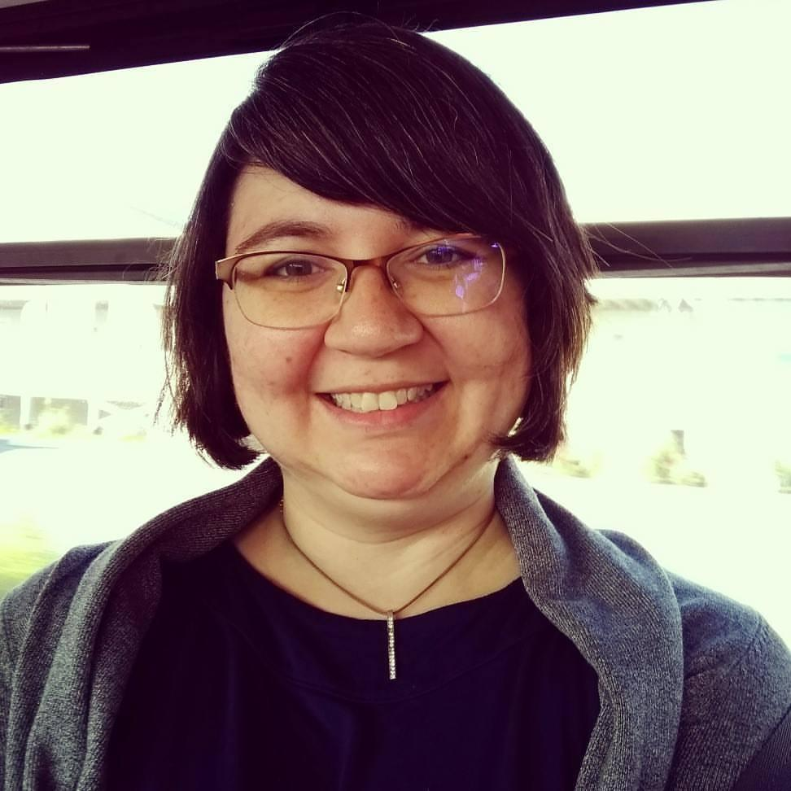
About Me
Jamie Klenetsky Fay
Digital Media Manager, Morris County
County employee for over 12 years
Web design, development, social media management, employee training,
project management and maintenance
jklenetsky@co.morris.nj.us
@jamieklenetsky

Slide 3
Morris County is a large agency...
Over 1450 employees
6 departments, 24 offices
Many independent, affiliated agencies
4 constitutional officers and a Board of 7 Chosen Freeholders

Slide 4
...which leads to social media management questions:
What offices get social media accounts?
Who can post to those accounts? How?
How can we keep track of what’s being posted, and who has access to which account?
Is it possible to maintain consistent branding?

Slide 5
Step 1: Policy

Slide 6
Set a social media policy.
What to consider:
Online social presence for the agency (“Morris County”), or several, depending on the office (“Morris County Clerk,” “Morris County Park Commission”)?
Who is in charge of social media management?
Who is allowed to post to social media, and who gives that permission?
How will social media posting comply with OPRA?
Who trains staff on using social media?

Slide 7
Examples from Morris County’s social media policy
The Morris County Office of Communications and Digital Media is responsible for recommending which Social Media services are appropriate for use by Morris County, including affiliated boards, commissions and authorities.
The County of Morris shall have a single presence on social media sites deemed appropriate for use. Requests for individual departmental or agency pages or sites must be approved by the County Administration, which may delegate this function to the Office of Communications and Digital Media.
The Office of Communications and Digital Media should be contacted for assistance with developing appropriate uses for social media, selecting appropriate social media outlets and defining a strategy for social media use.

Slide 8
Get the policy on the books.
Make sure the policy is
Approved by your governing body
Made available to staff
Read our policy at https://bit.ly/2WTYkv4.

Slide 9
Step 2: Working with agencies

Slide 10
Creating new accounts for agencies
Have an in-person meeting with stakeholders
Determine their social media goals
Based on goals, determine appropriate network(s)
Set up account(s) and provide credentials
Train users in posting, comments, and social media policy
Continue to consult with agency

Slide 11
Step 3: Management

Slide 12
Use a social media dashboard
What is a social media dashboard?
Manage different social media accounts from one dashboard.
Features may include:
Multiple team members
Post once to multiple platforms
Keep track of analytics across platforms
Schedule posts in advance
Track trending hashtags
Capture demographic information
Dashboard products
Buffer https://buffer.com/
Hootsuite https://hootsuite.com/
Sprout Social https://sproutsocial.com/
Friends+Me https://friendsplus.me/
Zoho Social https://www.zoho.com/social/
...and many more

Slide 13
Use a password manager
Why use a password manager?
Easily keep track of social media passwords
In high-pressure situations, don’t get caught without an important password
Simple to create complex, secure passwords, without needing to remember them
Share passwords across teams
Password Managers
LastPass https://www.lastpass.com/
Dashlane https://www.dashlane.com/
Zoho Vault https://www.zoho.com/vault/
Keeper https://keepersecurity.com/
Password Boss https://www.passwordboss.com/
KeePass (desktop-based) https://keepass.info/
...and more

Slide 14
Keep track of your accounts and users
Use a spreadsheet to note the following about each social media account:
  Social media network and handle
  What department owns the account
  What department maintains the account
  If the account is being archived
  If the branding is correct
Use a spreadsheet to track the following for each user on a social media account:
  Social media network and handle
  Name
  Email they use to login
  Username (if different than email)
  How they access account (social media manager, live site)

Slide 15
Archive your posts
Why archive?
OPRA/records retention laws (check with your records manager)
Legal protection in cases of deleted posts or comments
Easier to find old posts/campaigns that you might want to adapt or reuse
Archiving tools
ArchiveSocial https://archivesocial.com/
PageFreezer https://www.pagefreezer.com/
Smarsh https://www.smarsh.com/
Erado https://www.erado.com/social-media-archiving/
Mirrorweb https://www.mirrorweb.com/social-media-archiving

Slide 16
Questions?
Jamie Klenetsky Fay
jklenetsky@co.morris.nj.us
@jamieklenetsky
View presentation at
https://tinyurl.com/yxd9oo69

