Slide 1
Finding the Formula for Drug Savings
The Role of Pharmacy Benefit Managers in the Health Care System

Slide 2
Agenda for Discussion
Introduction
What a PBM is and What a PBM Does
PBM Contracting
What is the role of PBMs?
Questions

Slide 3
What Is a PBM?

Slide 4
What Is a PBM?
A pharmacy benefit manager (PBM) is a health care company that contracts with insurers, employers, and government programs to administer the prescription drug portion of the health care benefit
PBMs are patients’ primary advocates in the fight against rising prescription drug prices, negotiating with drug manufacturers and pharmacies for lower drug prices and higher quality.
PBMs aggregate the buying clout of millions of enrollees, enabling plan sponsors and individuals to obtain lower costs for prescription drugs.

Slide 5
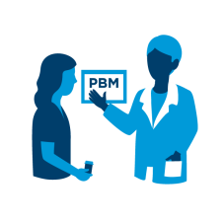



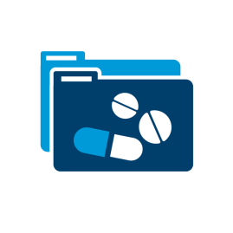




Why We Are Here
INTEGRATED CARE DELIVERY: Individualized. Proactive. Connected.
Plan & PBM
Labs & Diagnostics
Family & Caregivers
PATIENT
Pharmacies
Hospitals
Wellness Programs
Primary Care Physician and Specialists
Urgent Care

Slide 6
What Role Does a PBM Serve?
Pharmacy benefit managers (PBMs) negotiate on behalf of plan sponsors and administer the outpatient prescription drug portion of the health care benefit, in a high-quality, cost-effective manner.
PBMs aggregate the buying clout of millions of enrollees, enabling plan sponsors and individuals to obtain lower costs for prescription drugs.
PBMs are the only check in the retail Rx drug supply chain against drug makers’ power to set and raise prices.
1 Visante, Generating Savings for Plan Sponsors, Feb. 2016, available at: - https://www.pcmanet.org/wp-content/uploads/2016/08/visante-pbm-savings-feb-2016.pdf

Slide 7
PBMs’ National Footprint
More than 266 million Americans receive pharmacy benefits provided through PBMs
18.0%
Medicaid*
35.7%
Self-Insured Employers
266
MILLION
AMERICANS
14.7%
Medicare Part D
31.6%
Commercial Health Plans
*Excludes Medicare-Medicaid Dual Eligibles where drugs are covered by Medicare Part D.
Source: Visante estimates prepared for PCMA, 2016.

Slide 8
Snapshot of PBM Marketplace
Competition in PBM Marketplace is strong.
  66 PBMs in the U.S.¹
PBMs vary in size, geographic footprint, service offerings, expertise and focus.
Market changes: consolidation, vertical integration, new entrants.
PBMs’ net profit is lowest in supply chain.
¹Pharmacy Benefit Management Institute (PBMI) Data.

Slide 9


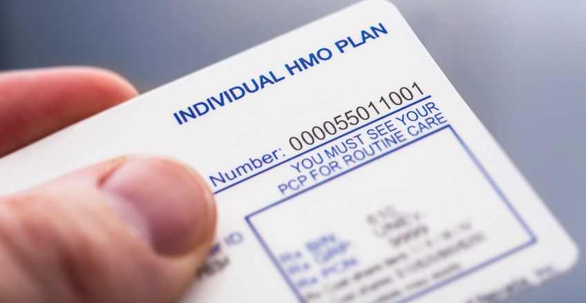

Who Are PBM Clients?
Private Sector Employers
Public Sector Employers
Commercial Health Plans/
Government Programs
Union Trusts/Taft-Hartley Plans (ERISA-exempt)

Slide 10
How Plans Hire PBMs: RFP Process
Plan Issues RFP
Request for Proposal (RFP) dictates the terms and conditions of the PBM services
PBM Bids
Multiple PBMs bid in a highly competitive environment
Plan Decision
Plan sponsor may utilize benefit consultants for direction
Decisions often reflect need of a robust pharmacy benefit that delivers cost savings
Plan Design
PBM provides options based on the plan sponsor’s unique needs
Plan sponsor makes the final decision about the drug benefit plan
PBMs offer various design models depending on plan sponsor’s specific needs

Slide 11
PBM – Plan Contracts
PBMs offer various design models depending on a plan’s specific needs:
  Plans choose how to compensate PBMs: traditional/spread, pass-through/fees, rebate share.
  Performance guarantees and audit rights protect plans and ensure transparency.
  On average, more than 90% of rebates negotiated by PBMs are passed through to plan sponsors.¹
The plan sponsor always has the final say when creating a drug benefit plan.
Things not determined by a PBM: benefit design, cost sharing levels, deductibles, etc.
1 Pew Charitable Trusts, “The Prescription Drug Landscape Explored”. 2019

Slide 12

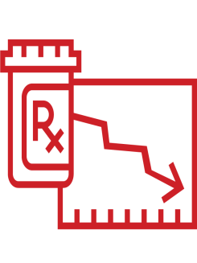
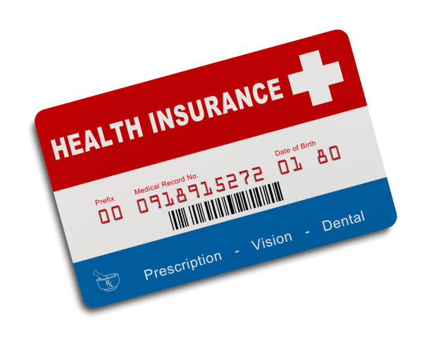


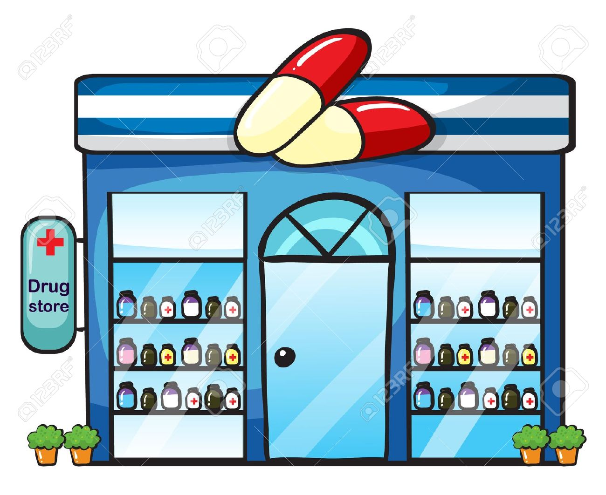
Drug Supply Chain
Drugmakers pay rebates to PBMs per negotiated agreements (on some drugs)
Drugmakers
PBMs
Set Drug List Prices
Negotiate discounts with drugmakers on behalf of their health plan clients or large employer clients
Drugmakers negotiate with PSAOs to distribute their drugs to pharmacies
PSAOs negotiate drug reimbursement on behalf of their pharmacy clients with PBMs
PSAO /
Wholesaler
Health
Insurance
Plans
PSAOs sell/distribute drugs to their pharmacy clients
PBMs/health plans pay pharmacy for drugs dispensed
Health insurance plans cover enrollees’ drug costs
Pharmacy
Patient pays copays for drugs
Patient
Pharmacy dispenses drugs to patient

Slide 13
What’s the Problem?

Slide 14
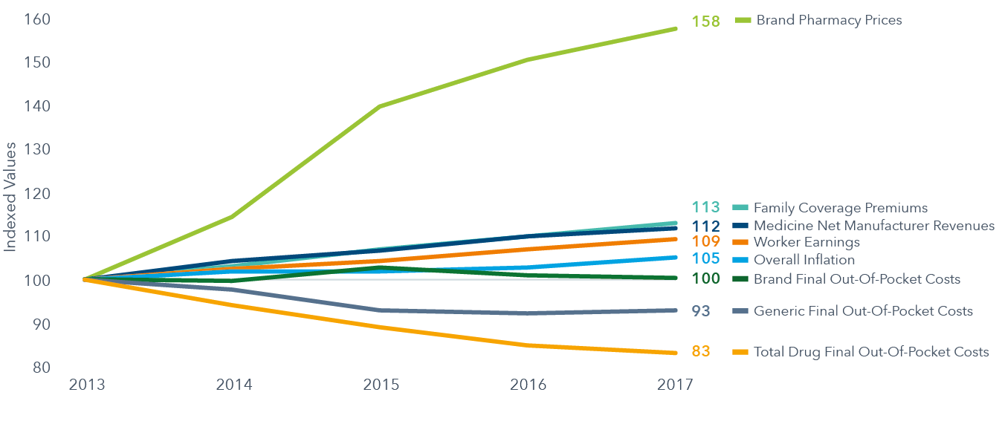
Brand Drug Prices Increased 58% 2013-2017
Changes in Healthcare Costs or Cost Drivers 2013-2017, Indexed (2013 Values + 100)
Source: IQVIA Institute. Medicine Use and Spending in the U.S.: A Review of 2017 and Outlook to 2022, April 2018. Kaiser/HRET Survey of Employer-Sponsored Health Benefits, 2017; IQVIA Formulary impact Analyzer (FIA). IQVIA Institute, December 2017.
Chart notes: Indices sourced from Kaiser/HRET Employer Survey4 include: family coverage, premiums, workers earnings, overall inflation. Brand, generic and total final out-of-pocket costs and brand pharmacy prices are for commercially insured, Medicare Part D and cash payment types sourced from IQVIA Formulary Impact Analyzer. All charted values are indexed to set their 2013 value equal to 100.

Slide 15
Prices for Top Brand Drugs Have Doubled Since 2012
LIST price twice as high on newer drugs
NET price twice as high on newer drugs
Source: Visante estimates and analysis of SSR Health data, 2017.
Note: Visante analyzed data on the top 200 drugs by 2016 gross sales. Visante examined list prices (WAC) and net prices (net of estimated rebate) during the period 2007-2016, where a category had only one drug, and then a second drug entered the category as a new competitor. Rebates for the new competitor in the category are usually more than the rebates for existing product, but the entry list price for the new competitor is often less than or equal to the existing product.

Slide 16
Why Are Manufacturers Increasing Prices? To Counter Shrinking Prescription Volume for Brand Drugs
Brand Prescription Volume Has Plummeted as Generics Have Replaced Brands
Meantime, Brand Drug Prices Have Skyrocketed to Maintain Revenues
Brand
Rx Volume
Brand
Rx
Prices
Source: Visante analysis data published by the IQVIA Institute, 2018.

Slide 17
Growth of Specialty Drugs
More than 30% of all specialty drugs have been approved since 2014.
Patients who use specialty medications made up about 4.9% of commercially insured member populations in 2017, up from 3.9% in 2015.
Specialty drug spend is now 50% of total drug spend and is forecasted to reach 60% by 2021.
Sources: Pharmacy Benefit Management Institute. Trends in Specialty Drug Benefits, 2019; RJ Health Systems. Trends in FDA Approvals of Specialty Drugs 1990 through 2017, December 15, 2017; and Prime Therapeutics, The Inevitable Increase in Specialty Growth, November 2017.

Slide 18
Who Pays for Prescription Drugs?
Source of Payment for Outpatient Prescription Drug Expenditures, 2016
³
⁴
¹
²
Includes workers’ compensation and Pembroke Consulting estimates for employer share of private insurance.
Includes those with Medicare supplemental coverage and all individually purchased plans, including coverage purchased through the Marketplaces. Figure reflects Drug Channels Institute estimates for prescription drug spending for individually purchased private insurance.
Includes Children’s Health Insurance Program (Titles XIX and XXI), Department of Defense, Department of Veterans Affairs, Indian Health Service, workers’ compensation, general assistance, maternal and child health, and other federal, state, and local programs. Other federal programs include OEO, Federal General and Medical, Federal General and Medical NEC, and High Risk Pools under ASA. Other state and local programs include state and local subsidies and TDI.
Consumer out-of-pocket expenditures equal cash-pay prescriptions plus copayments and coinsurance.
Source: Drug Channels Institute analysis of National Health Expenditure Accounts, Office of the Actuary in the Centers for Medicare & Medicaid Services, December 2017. Totals may not sum due to rounding. Data exclude inpatient prescription drug spending within hospitals and nearly all provider-administered outpatient drugs.

Slide 19
Drug Manufacturers Reap 67% of Rx Dollars
Retained Revenue Across U.S. Pharmaceutical Sector, 2016 ($billions)
Source: Nancy L. Yu, Preston Atteberry, Peter B. Bach. “Spending On Prescription Drugs In The US: Where Does All The Money Go?” Health Affairs, July 31, 2018.
Note: Study does not take into account the full amount of manufacturer rebates that PBMs may pass along to clients, which may lower estimated PBM retained revenue.

Slide 20
Pharmaceutical Supply Chain Profit Margins
Source: The Flow of Money Through the Pharmaceutical Distribution System. Schaeffer Center for Health Policy & Economics, University of Southern California. June 2017

Slide 21
Tackling High Drug Costs
Patient cost-sharing often represents only a small fraction of the total cost of the drug.
Brand drug manufacturers establish prices within a monopoly established by federal patent law.
Until other drugs are approved for the same disease or condition, manufacturers have little incentive to reduce their prices.
Health plans and PBMs do not have any control over the price the manufacturer sets for a drug — but PBMs have some tools to drive down drug costs.

Slide 22
What Is the Role of PBMs?

Slide 23



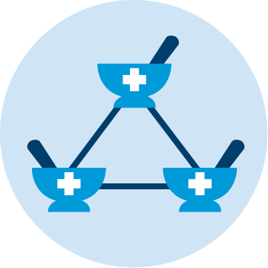
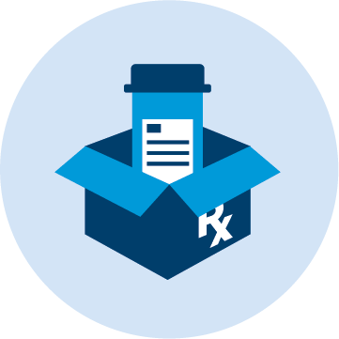

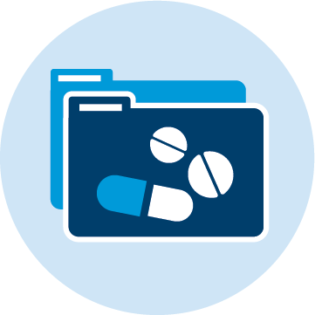

Pharmacy Benefit Management Services
Claims
Processing
Price, Discount and Rebate Negotiations with Pharmaceutical Manufacturers and Drugstores
Formulary Management
Pharmacy Networks
Mail-service Pharmacy
Specialty
Pharmacy
Drug Utilization Review
Disease Management and Adherence Initiatives

Slide 24
PBM Savings in New Jersey
With the use of PBM tools and services, between 2016-2025, New Jersey commercial insurance payers will save $10.6 billion.¹
Recently, many states have looked to, or enacted legislation that restrict the use of PBM tools that reduce spending on prescription drugs.
If enacted, some laws come with serious financial costs²:
  Mandated Disclosure of Proprietary Information: $1.6 Billion
  PBM Fiduciary Mandate: $2.1 Billion
  Restrictions on Step Therapy and Prior Authorization: $1.7 Billion
  Any Willing Specialty Pharmacy: $1.1 Billion
1.Pharmacy Benfeit Managers: Generating Savings for Plan Sponsors and Consumers Visante, 2016
2.Increased Costs Associated with Proposed State Legislation Impacting PBM Tools. Visante, 2019.

Slide 25
How Do PBMs Drive Savings for Patients?
Pharmacy Networks
  PBMs build networks of pharmacies that compete on service, convenience, and quality to attract consumers in a particular health plan. This competition keeps prescription drug costs down.
Home Delivery of Drugs
  Health plans and employers offer their members and employees less expensive prescriptions for 90-day supplies of medications when they choose home delivery.
  Mail-service pharmacies can offer lower prescription drug prices because they have lower overhead costs and are often more efficient than other types of pharmacies.

Slide 26
How Do PBMs Drive Savings for Patients?
Incentivizing Use of Generic Drugs
  PBMs help save money by using innovative management tools to increase the use of generic drugs, which are as safe, but less expensive than name brands.
Drug Price Negotiations and Rebates
  PBMs help rein in out-of-control prescription drug prices by negotiating price discounts and rebates from pharmacies and drug manufacturers.

Slide 27
Payers Increasingly Reliant on PBM Tools
2015
2017
Source: Drug Channels Institute analysis of Health and Well-Being Touchstone Survey Results, PwC, various years.

Slide 28
PBMs Aggressively Encourage Generic Drug Use,
Generic Dispensing Increasing as a Result
Source: IQVIA

Slide 29
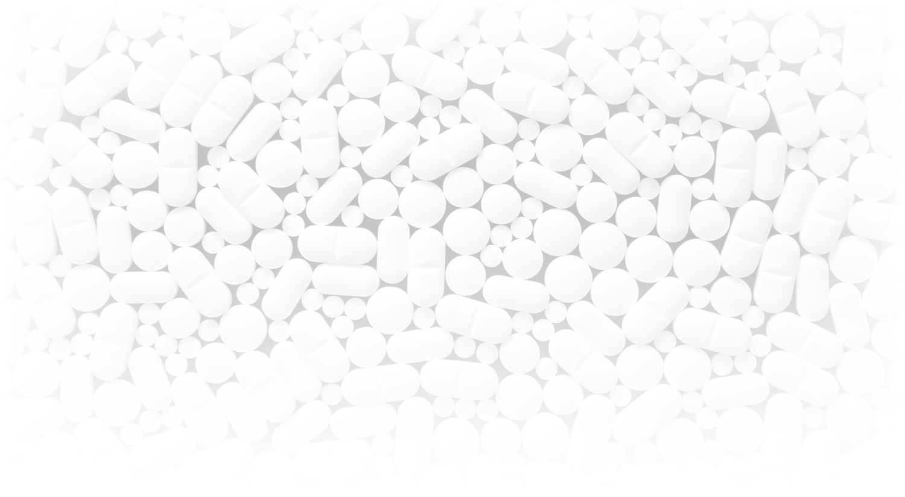
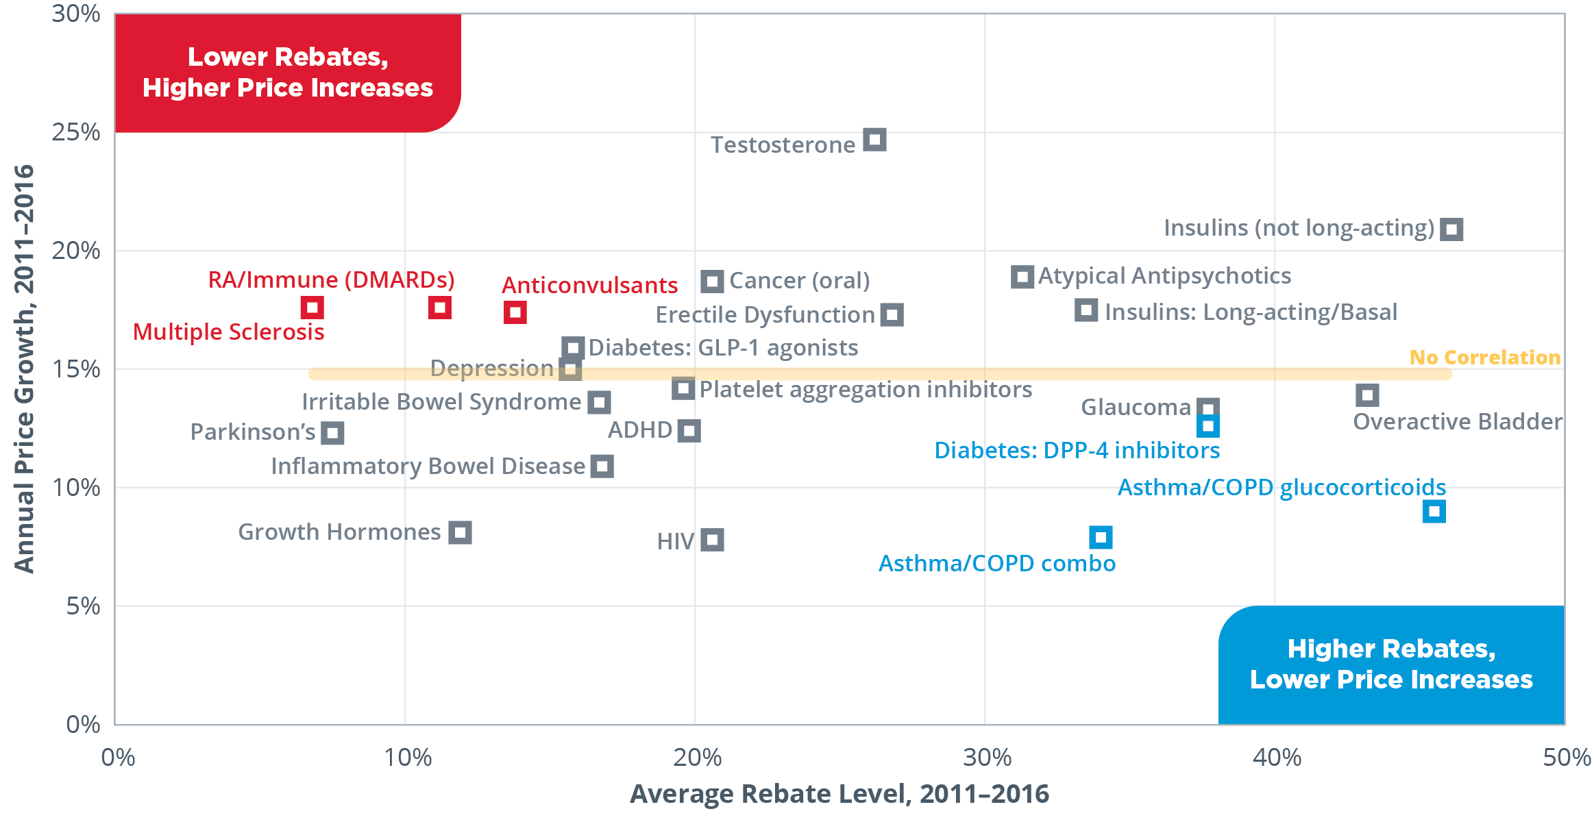

Study Shows No Correlation Between Drug Rebates and Price Increases
Major Findings:
No correlation between drug prices and PBM/payer rebates
Cases exist of higher-than-average price increases with relatively low rebates
Cases exist of lower-than-average price increases with relatively high rebates
Drugmakers are increasing prices regardless of rebate levels
Study: Top 200-self-administered, patent-protected, brand-name drugs in 23 major drug categories examined.
Source: Visante, No Correlation Between Increasing Drug Prices and Manufacturer Rebates in Major Drug Categories. (April 2017).

Slide 30
What Would the World Look Like Without PBMs?
Without management of Rx benefit, 40-50% more in costs¹
  No one to make drug manufacturers compete with each other
  No competition on price or quality in the pharmacy space
  No auditing of pharmacies for fraud, waste, and abuse
  No utilization controls that reduce waste and increase adherence
  Paper claims, longer claims processing times, inability to have real-time reimbursement and coverage information for consumers at the pharmacy counter
  Less utilization of generic drugs
¹ Visante, The Return on Investment (ROI) on PBM Services. (November 2016).

Slide 31
Conclusion
Drug list prices for both brands and generics are going up.
PBMs play a unique and central role in driving adherence, holding down costs, and increasing quality.
PBM tools deliver savings for plan sponsors and consumers, underscoring the success of the competitive marketplace.
Questions?

