Slide 1
Borough of Franklin Lakes
Performance Management
New jersey League of municipalities conference
Data based decision making: a best practice
wednesday, November 17, 2021

Slide 2
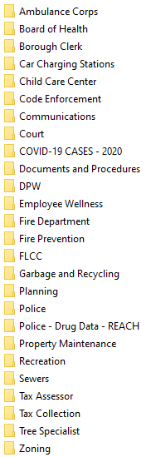
Who is Reporting Data?
What is Being Measured?
Measure Name
Amount to Borough
Amount to County
Amount to POAA
Public Defender Fees Collected
Amount to other agencies
Amount Collected (Total Income)
Criminal backlog - D.P. & P.D.P. offenses
Criminal backlog - Ordinance offense
D.P. & P.D.P. offenses added
Total Criminal offenses disposed
Indictable offenses added
Total Criminal offenses added
Ordinance offenses added
Ordinance offenses disposed
Traffic backlog - DWI
Traffic backlog - moving violations
Traffic backlog - parking
Traffic violations added - DWI
Traffic violations added - moving violations
Traffic violations added - parking
Traffic violations added - total
Traffic violations disposed - DWI
Traffic violations disposed - moving violations
Traffic violations disposed - parking
Traffic violations disposed - total
Number of Cases Heard
Number of Court Sessions
Length of Court Session
Number of Cases Disposed by Affidavits
Number of Cases/Traffic violations disposed
Plea by mail - sent
Plea by mail - returned
Borough now has 24 “departments” recording data in its performance management system
Each department has performance measures – monthly or quarterly and annual data that measures departmental performance

Slide 3
Reports
Reports which visually show performance through graphs are prepared by department heads on a monthly or quarterly basis and provided to the governing body.
  Department head chooses which measures to feature.

Slide 4
Quarterly Reports

Slide 5
Quarterly Reports

Slide 6
Annual Reports
Annual Reports show performance over time.
  Demonstrate trends
  Use of trend lines make it easy to visualize

Slide 7
Annual Reports

Slide 8
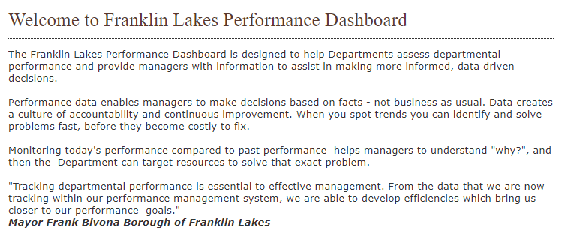
Performance Dashboard
Selected reports are posted on the Performance Dashboard on the Borough website for the public to learn about the department and its performance
    18 “departments” are currently posting reports on Performance Dashboard
    Performance Dashboard shows Quarterly and Annual Reports

Slide 9

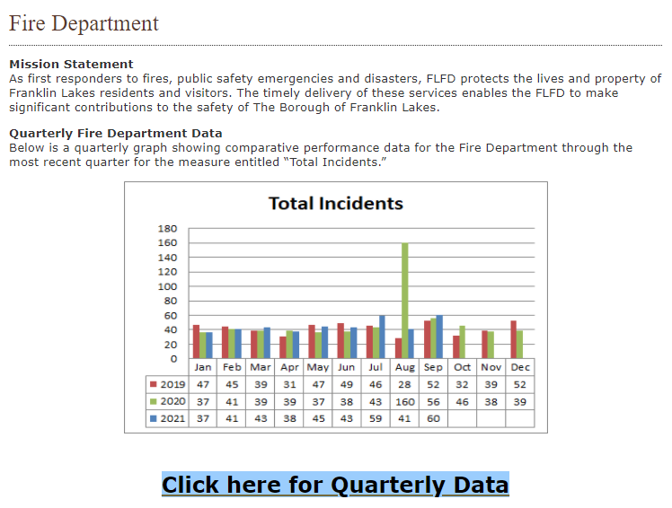
Performance Dashboard

Slide 10
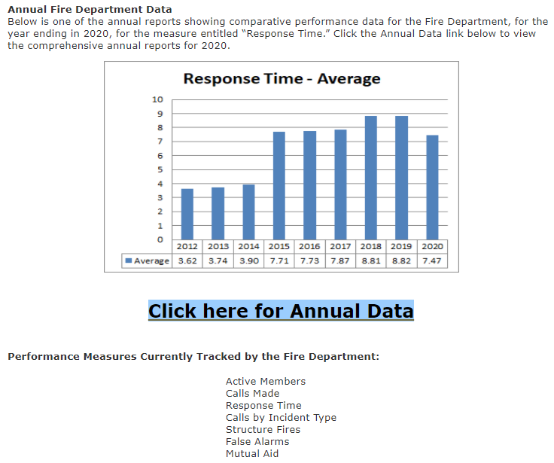
Performance Dashboard

Slide 11
Managing With Data
Budget Decisions - Personnel

Slide 12
Managing With Data
Measuring Success
Understanding Issues

Slide 13
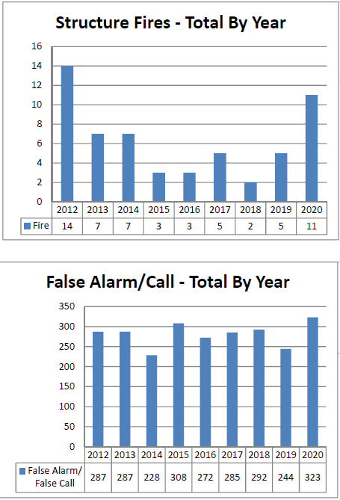
Managing with Data
Identifying Problems

Slide 14
Managing with Data
Dimensioning Issues

Slide 15
Public Information & Engagement
As managers, we must measure performance
  Use data to more effectively management
As public managers, we must share that performance data with the public
Educate and inform the public
  Good governance and they like it
Picture tells the story (don’t it?)
Don’t be afraid
  Constructive tool to help department heads and governing body’s manage
Embrace the “Why” questions

Slide 16
Thank You
Gregory C. Hart, CPM, QPA
  Borough Administrator, Borough of Franklin Lakes
  GHart@franklinlakes.org
  (201)891-4000, ext. 1201

