Slide 1


Data Based Decision Making:
A Best Practice
New Jersey League of Municipalities Conference
November 17, 2021
Anthony Ferrera
NJMMA Vice President, Hillsborough Township Administrator

Slide 2

WITHOUT DATA
YOU’RE JUST ANOTHER PERSON
WITH AN OPINION
W. EDWARDS DEMING

Slide 3

IF WE HAVE DATA LET’S LOOK AT DATA.
IF ALL WE HAVE ARE OPINIONS,
LET'S GO WITH MINE.
JAMES L. BARKSDALE, FORMER NESTCAPE CEO

Slide 4
2021 Q3 Department Status Reports
Business Advocate
Administration
Building Department
Engineering
Finance
Health Department
Office of Emergency Management
8. Parks and Recreation
9. Planning and Zoning
10. Public Works
11. Social Services
12. Tax Assessor
13. Technology

Slide 5
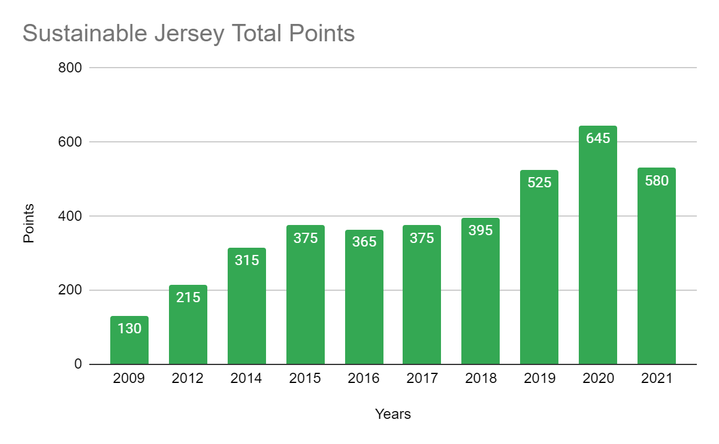
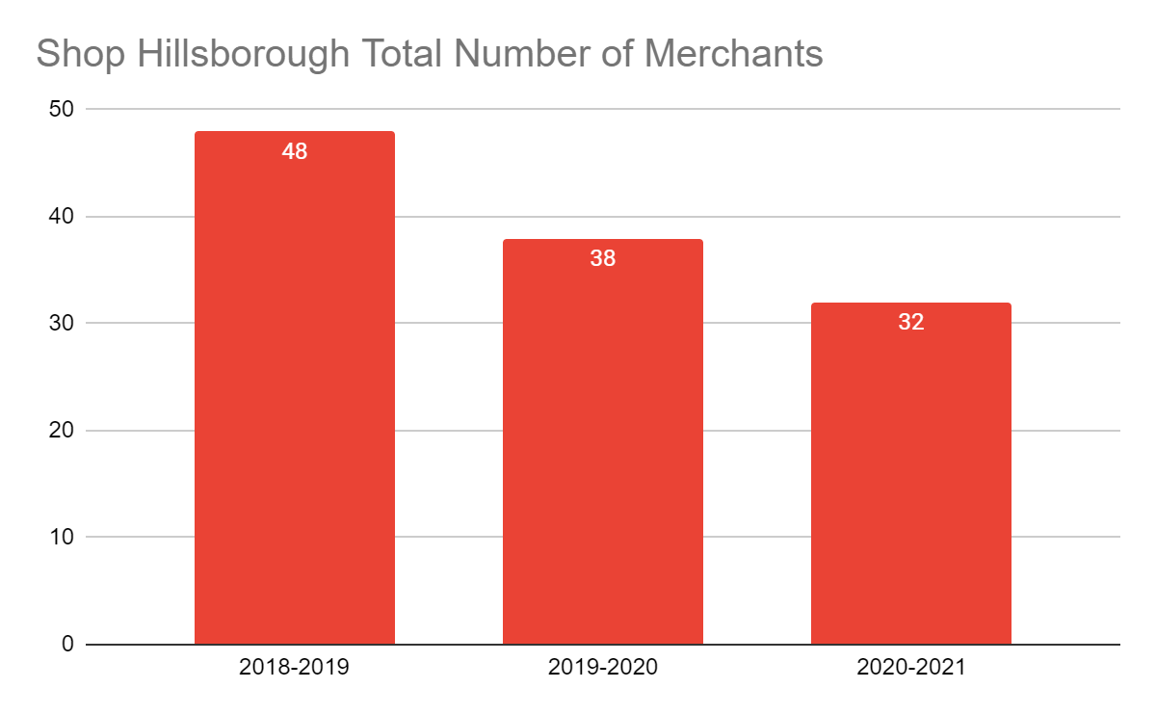
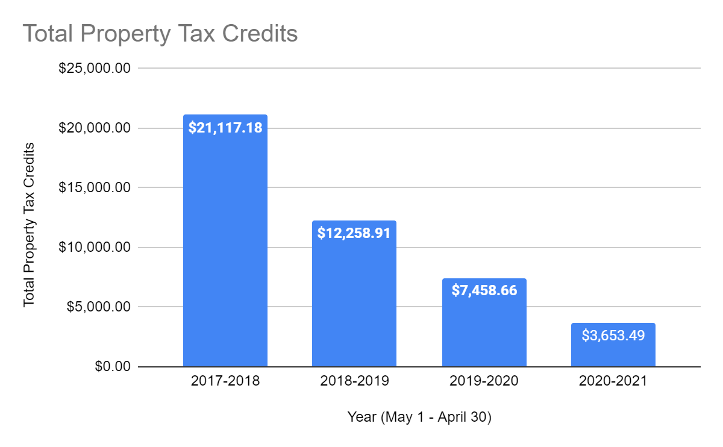
Business Advocate / Sustainability
Sustainable Jersey Certifications
  Established Criteria for G&O
  EV Charging Grant
Sustainable Community Education & Outreach
COVID-19 Pandemic Recovery Response:
  Digital Newsletters / Social Media / YouTube
  Business Development & Promotion
Economic Development Report
Route 206 Bypass & Widening
Restaurant Week
REACH / College Interns & Volunteer Projects
250th Anniversary
Training of Full-Time Staff positions (Business Advocate & Planning/Zoning Depts.)
Digital Business / Event Promotion
Worked directly with impacted businesses and promoted post Ida relief/grants for businesses
Duke Farms Farmers Market Partnership to promote Township initiatives
Assisted Duke Farmer’s Market finishing #1 in NJ (2021 Farmer’s Market Celebration)
Continued progress (prep work) on EV Charging Grant at Municipal Complex
4th Annual Restaurant Week was a success
Participated in 250th Anniversary festivities
On pace to exceed 2020’s Sustainable Jersey point total (November 21st Deadline)
Shop Hillsborough Program lost 1 participating business since last quarter
HBA networking social planned for December
Evaluating ordinances to promote economic development and sustainability
Sustainable Jersey Certification
Coordinating Sustainable related programs between multiple departments
Continued training of Full-Time Staff positions (Business Advocate & Planning/Zoning Depts)
Neulook Consulting to take on another client

Slide 6
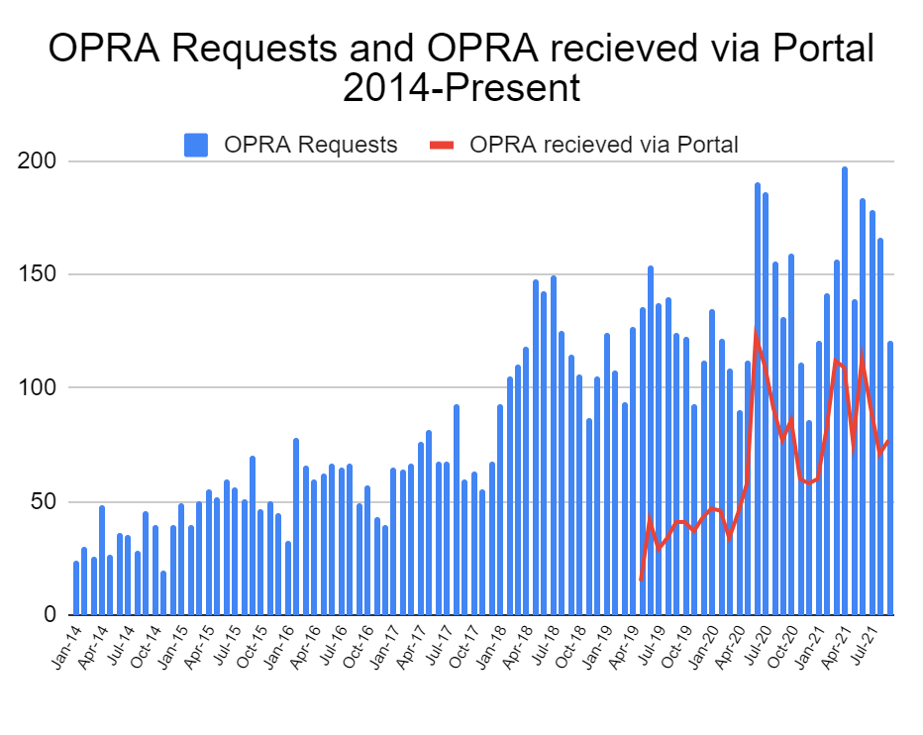
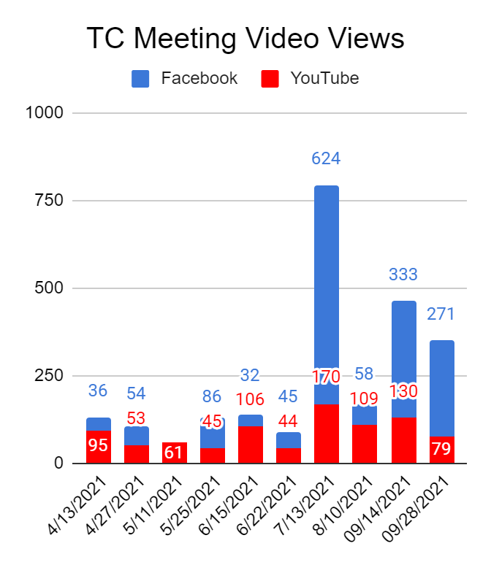
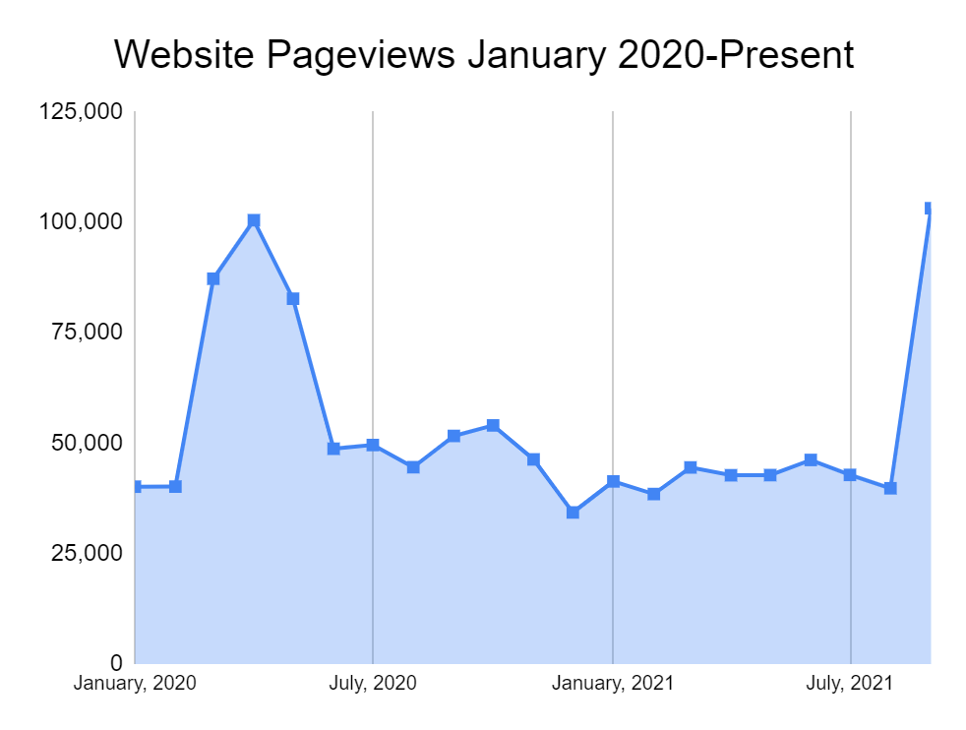
ADMINISTRATION / CLERK’S OFFICE
State Certification of Imaging System
Early Voting - ongoing
Wrapping up the 250th
RVCC Service Learning Student
Next up Contract and Liquor Licenses review for destruction
Rental Properties to be entered in SDL
Annual Appraisals in CIVIC-HR implementation
VERY IMPORTANT - for the public to access SDL from the website - it is now called ONLINE FORMS & REQUESTS
Wildlife Program 2021
Purple Heart Ceremony
Presented at NJMMA on Post pandemic positives
250th Parade & Library Display
Scarecrow Contest - Annual event
MCANJ Spotlight Award to Sarah Brake
25 Boxes applied for destruction (all wetlands comp.)
Breaking News Segments
Floater List - fully staffed
26 Raffle and Bingo licenses processed as a
All Vacant and Abandoned registrations entered in SDL
Fall Newsletter
Streamyard implementation
WFH policy implemented and in handbook
Veterans Day - Ted Dima Guest Speaker
Hillsborough Day at the NJ Devils Game 11/13
Goals and Objectives in Civic HR 2022
Time capsule for 250th
Final 2021 TC meetings: 11/9 and 12/14, Reorg is Wednesday, January 5, 2022
Ongoing records management of files within the office
Developing checklists for licensee applications
eCode training coming soon - learn what you can do and make notes in the code

Slide 7
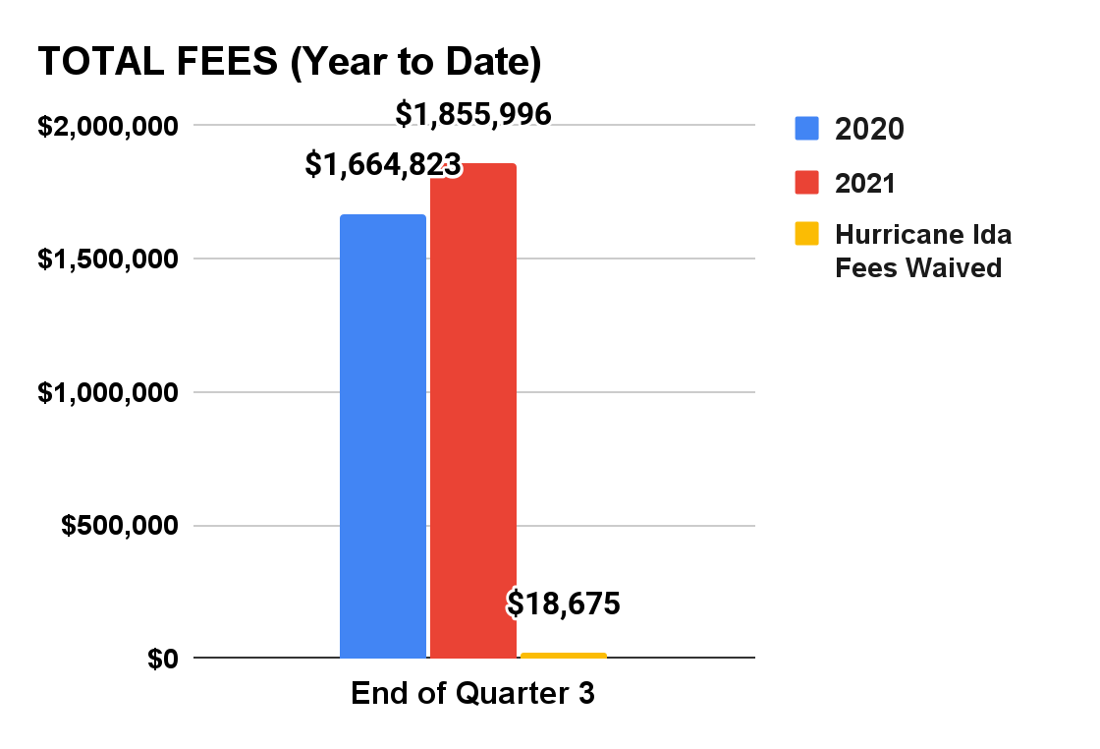
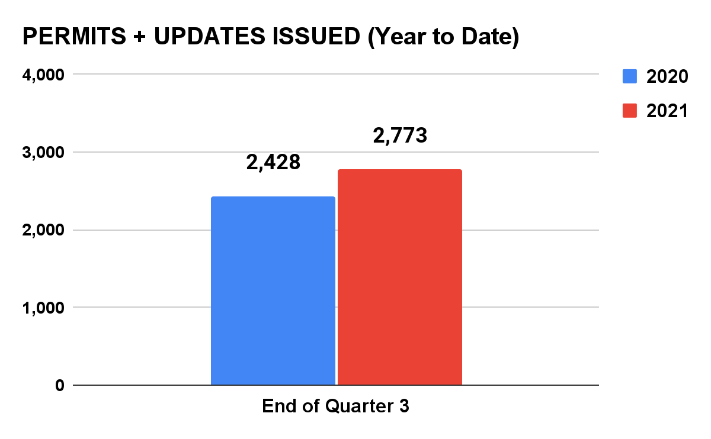
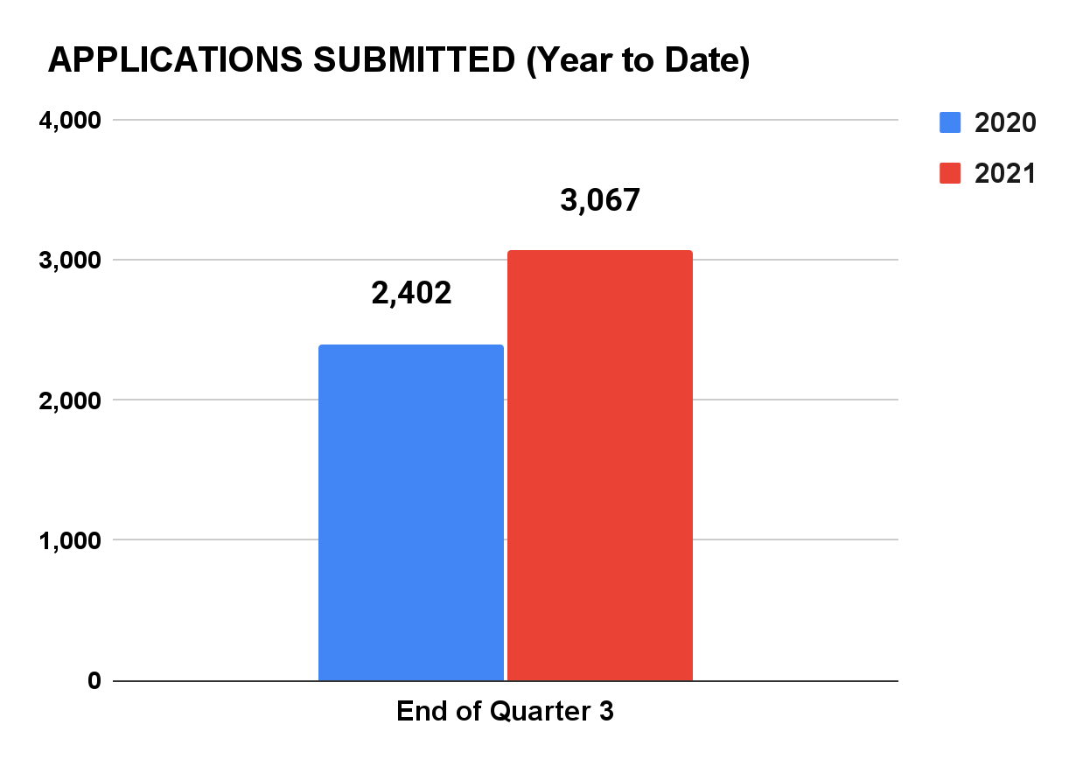
Building Department
New Projects---Avalon, Xfinity, Jill Ct--Bldg 15 & 16, Starbucks, Wendys, Weis, K-9 Resorts, RPM
Ongoing inspections--Hillsborough Radiology, Amwell Terrace, Hills.Village, Ramaswamy, Belle Mead Hot Glass, CW Brewery, Gateway, Brookhaven, Hills. Schools, Village Point, Hills. 206 Holdings
CO’s issued--Swiss Orthopedic, Iron Peak, RWJ
CCO’s issued--Auto Plus, Princeton Search, Wildfire Tech. Integration, New Kang Da Health Center, Princeton Search, Bezwada Biomedical, Polymer Cleaning Tech
TCO’s issued--Primrose and TCO’s extended for 221 HR Massage and YMCA
Bldg staff working with Engineering & Tax Assessor on a process to ensure pool permits are closed
The Building Staff worked tirelessly as a team to inspect & process permits due to Hurricane Ida which took priority
TA’s are now using BRT in place of Vitals
As of Oct 1, 2021 there are 147 permits totaling $69,758 waiting for pick up/payment
The Building Subcode acquired unanimous nomination for President for CJCOA (Central Jersey Code Official Assoc.)
Bldg Inspectors completed plan review training Module 1 and now working on Module 2 & 3.
Bldg Subcode created a user friendly collection of primary code documents & resources called The Ultimate Book of Survival Gear for inspectors, contr. & professionals
This quarter 3,365 inspections were conducted along with approx 200 courtesy inspections due to Hurricane Ida.
C.O. re-elected as President of NJBOA & will be sworn in at NJ League of Municipalities
Hills. Crossing Village--10 dwelling units and commercial
RPM Development--88 dwelling Units.
Hillsborough 206 Holdings--175 dwelling units and commercial
Brookhaven Loft Apartments and Hotel
LD Constr--191 dwelling units & commercial
Gateway building 35 SFD yearly with 150 to build
Bilkoo Gas & Convenience Store
Negotiating removal costs with Allstate--to move archived permit boxes from Allstate to DocuSafe for a Significant Cost Savings
Foveonics will be picking up 40 more boxes of closed permits in November which will be digitally archived
Village Point--44 apartments
Country Classics--decided to build two more houses

Slide 8
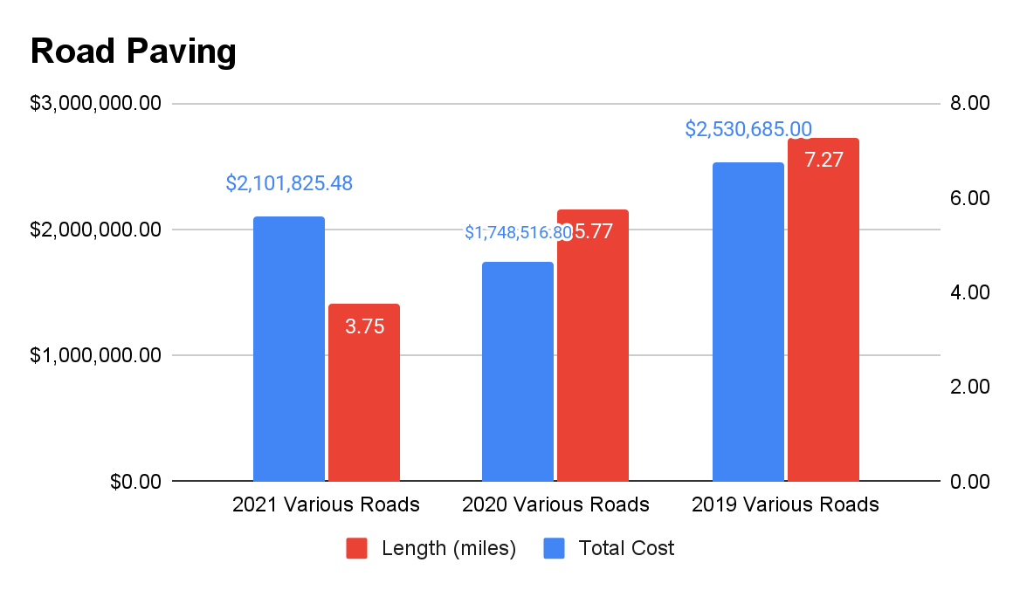
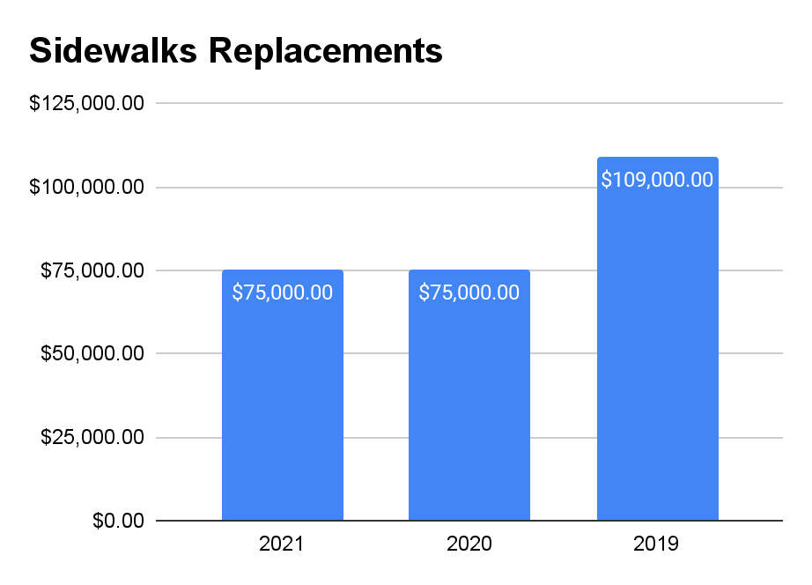
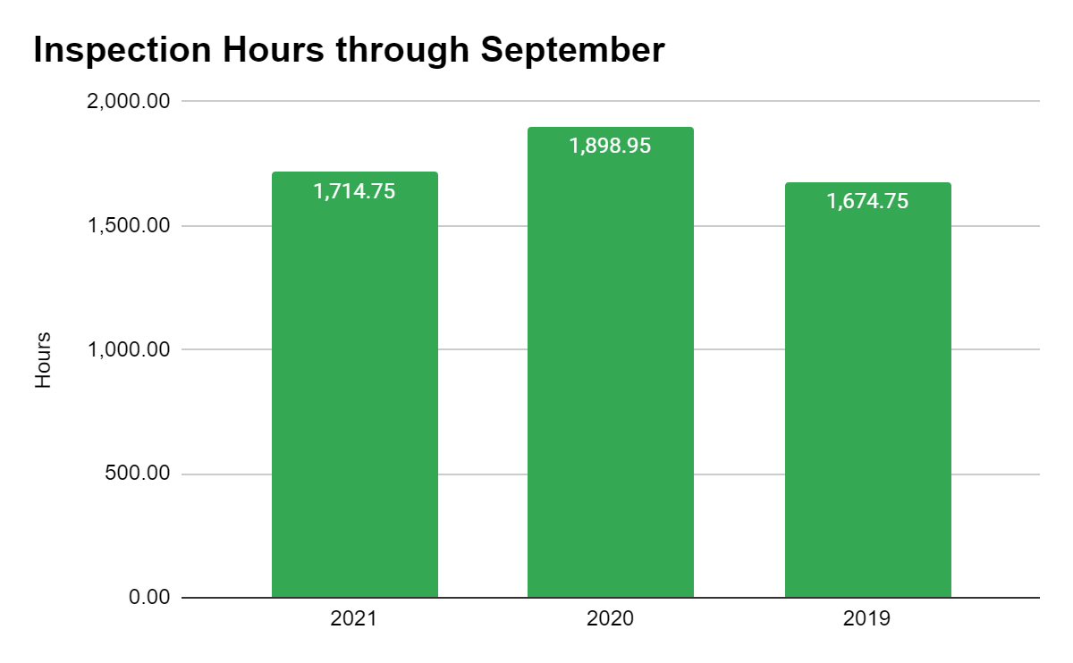
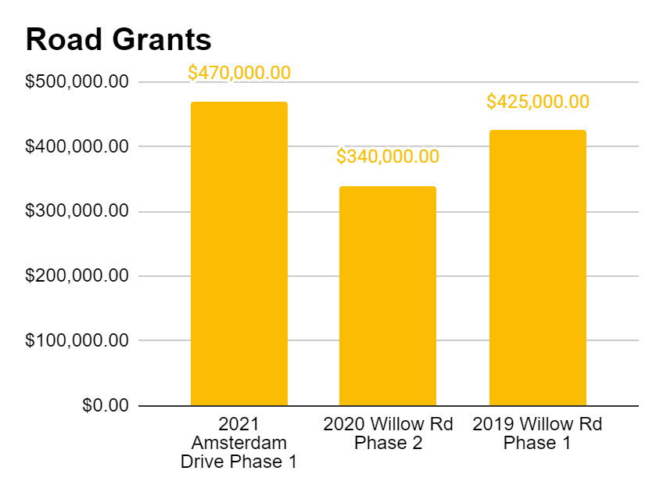
Engineering
2020 Roads
- Andria
- Hillsborough
- Wertsville
- Brooks
- East Mountain
- Green Hills
- Mountain View
- WIllow
2021 Roads
- Brooks Blvd (half width)
- East Mountain Rd
- Mountain View Rd
- Williamsburg Dr
- Weybridge Dr
- Bywater Way
- Bywater Ct
- Rivendell Rd
- Dunedain St
- Silverlode Ct
-Snowbourn Pl
- Lorien Pl
-Amsterdam Rd (Ph1)
2019 Sidewalks: Bloomingdale & AVM Park
2020 SIdewalks: AVM Park, Taurus, Meadowbrook & Clawson
2021 Sidewalks: Stockton, Hughey, More, Gafney, Shugal, Buckland
Ongoing Developments
Amwell Terrace
Apex
Ramaswamy
Gateway
Green Village
Primrose School
Hillsborough Village
Village Point
Hillsborough Ind. Park
Hillsborough Crossings
Hillsborough 206 Holdings
Other smaller developments
Other Projects
PSEG Gas Project
Willow Rd Phase 2 Paving
NJDEP Annual Stormwater Report
Amsterdam Drive Phase 1 Project
Updating tax maps & GIS parcel maps
Update Stormwater Ordinance
Drainage impact due to storm Ida
Completed 2021 Road Paving project ahead of schedule
Working with PSE&G Gas projects
Completed sidewalk repairs ahead of schedule
All staff obtained on Green Infrastructure Champion Certification
Completed Willow Road Phase 2 Grant project
Revised Road Opening Ordinance
Handling residents on the overwhelming requests for road repaving of their street
Due to storm Ida, now dealing with large volume of drainage complaints from residents
Working with Pennoni Associates to develop a road evaluation plan & map of all roads within Township
Developing a road presentation plan including methods more cost effective than milling & repaving
2022 Local Aid Grant for Phase 2 of Amsterdam Drive
Completing Phase 1 of Amsterdam Drive (2021 Local Aid Grant)
Sidewalk replacement of Flemming Drive
Looking into additional grants
Become more versed in Green Infrastructure methods
Enhance stormwater ordinance to help get sustainable points for the Township
Working on 2022 Capital Budget

Slide 9
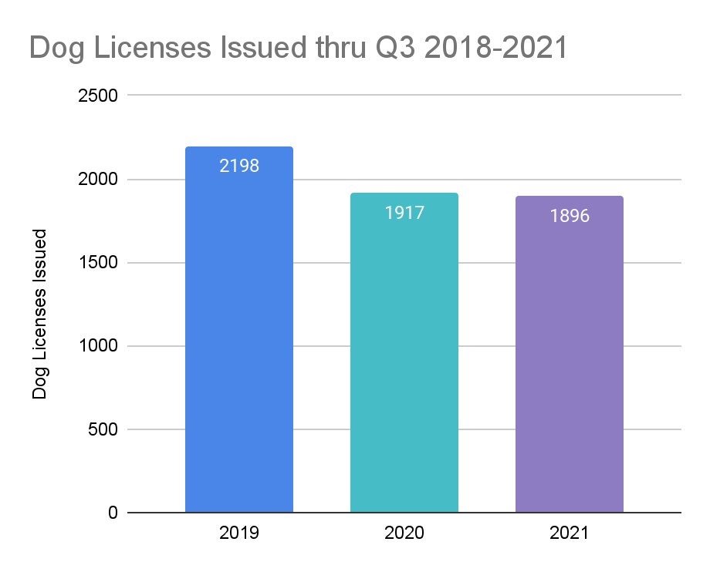
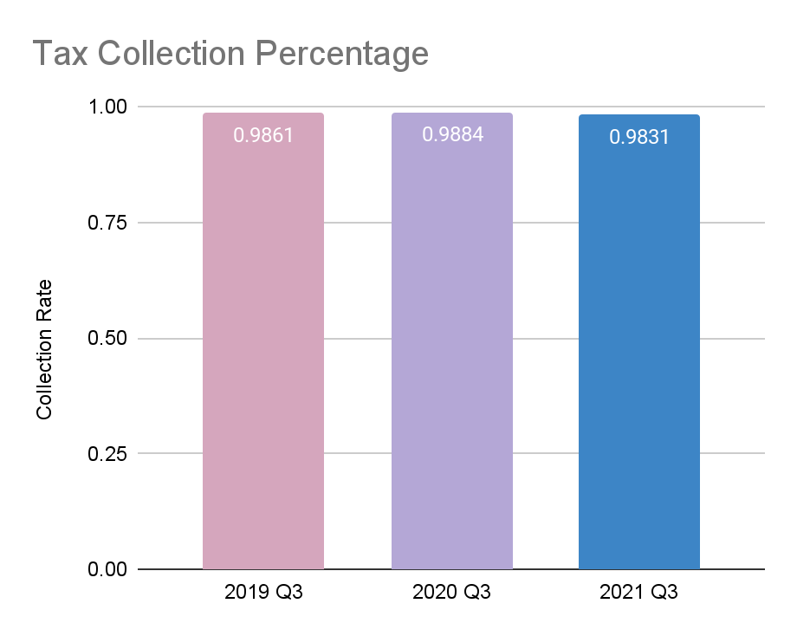
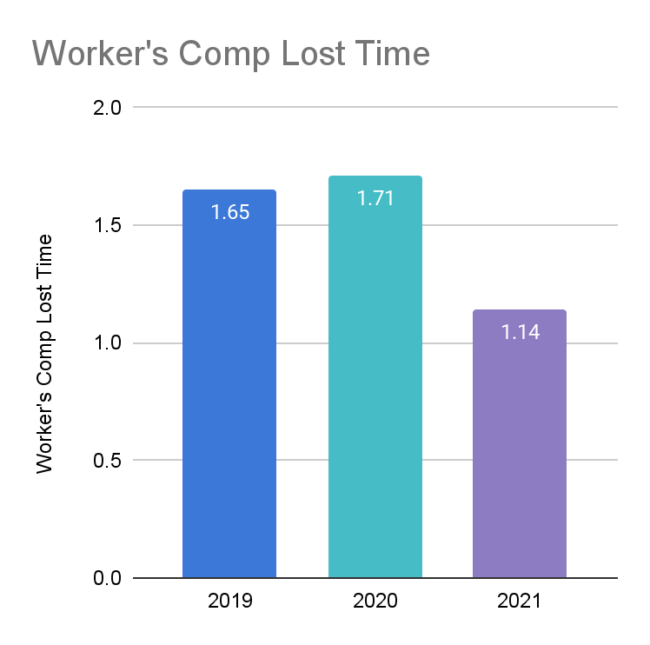
Finance
Increase Cyber Security training for CJIIF which is currently at 49%
Training and Cross Training of Entire Staff
Working with OEM and FEMA for submission and reimbursement of Hurricane Ida expenses
Creating spending plan for the American Rescue Funds over the next 3 to 5 years
Work with State of New Jersey on Local Gov’t Energy Audit, after award was awarded, to determine cost and energy savings for the municipal building and the public works buildings, as well as grant funding for those recommendations
Completion and acceptance of 2020 municipal audit
Awarded contract to Grant Writer based on RFP
Completed tax sale for unpaid 2020 taxes and other municipal charges on 9/15/21 with lowest number of properties sold since 2005 at 72 properties
Adoption of 2021 Capital Ordinance
Completion of 2022 renewals documents for CJJIF
Worked with Administrator to obtain MOA for the 2 labor contracts expiring on 12/31/21
Working with intern on Green Purchasing Policy
Prepare RFP for 2022 Professional Services
Create a document with links to State Contracts and all Coops to allow departments to research large items (i.e. vehicles etc) they may wish to request through the Capital Committee or purchase through their budgets

Slide 10
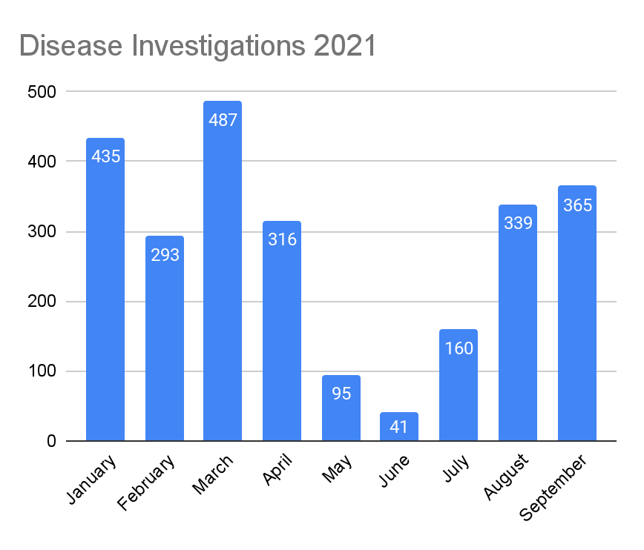
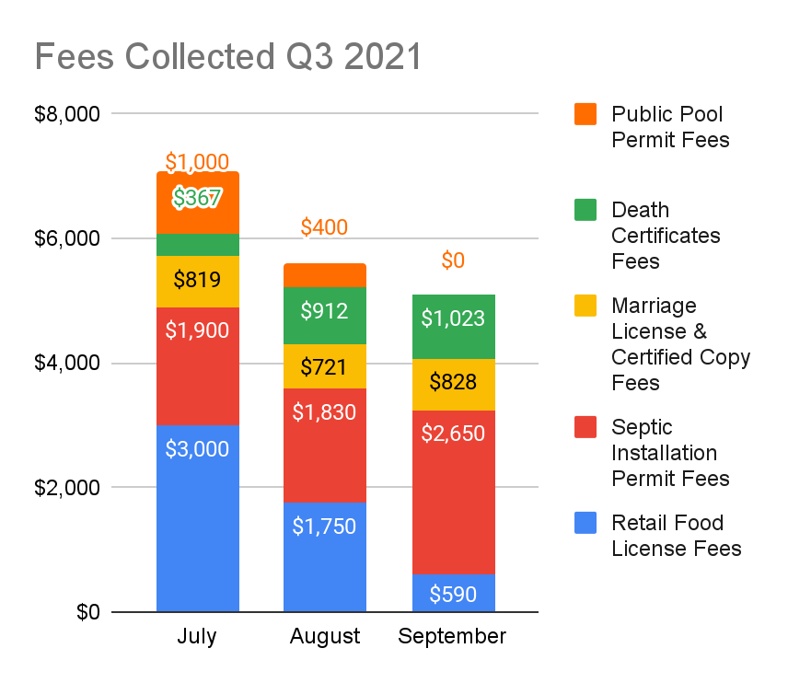
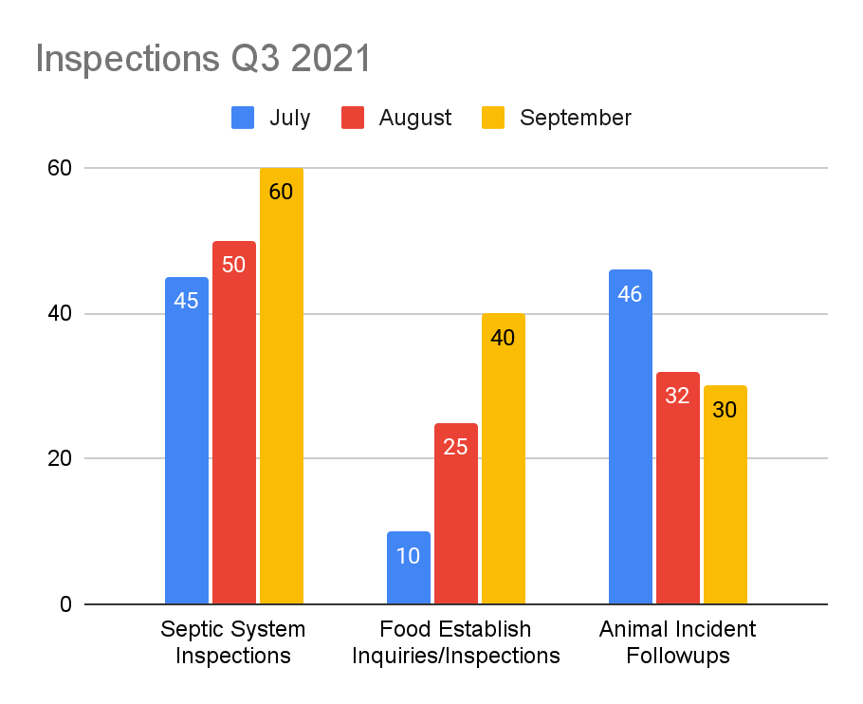
Health Department
Collected 280 well water samples for testing
Conducted 6 Covid 19 clinics at apartment complexes, YMCA, Iron Peak, Toro Care
Conducted 2 flu vaccination clinics
Attended Rotary Fair with games for Covid 19 prevention education.
Received 2 grants for Covid 19 - Strengthening Local Public Health until July 2022 and Supplemental Vaccination Funds for Covid 19 vaccination clinics until 2022.
Hired Covid 19 generalists: public health nurse and health educator. Also one additional nurse vaccinator.
Finished giving out 100 radon test kits
Board of Health resolution passed to allow the health department to be included on property deed for advanced wastewater treatment system maintenance.
Planned water testing program with Raritan Headwaters
Planned Covid 19 vaccination clinics, educational and promotional activities
Planned water testing for post- Ida impact on well water
Lead Poisoning Prevention Education Development
Lead Poisoning Investigations
Training of part time Property Maintenance/Code Enforcement Officer
Covid 19 education for child care facilities
Continuing Covid 19 vaccinations. Planning and implementing booster vaccinations
Planning Covid 19 vaccination clinics for ages 5-11.
Completing counts for Raritan Valley Headwaters water testing program
Planning to acquire more radon testing kits.
Working on amendments to the animal control ordinance to enable township to collect fines for animal cruelty cases

Slide 11
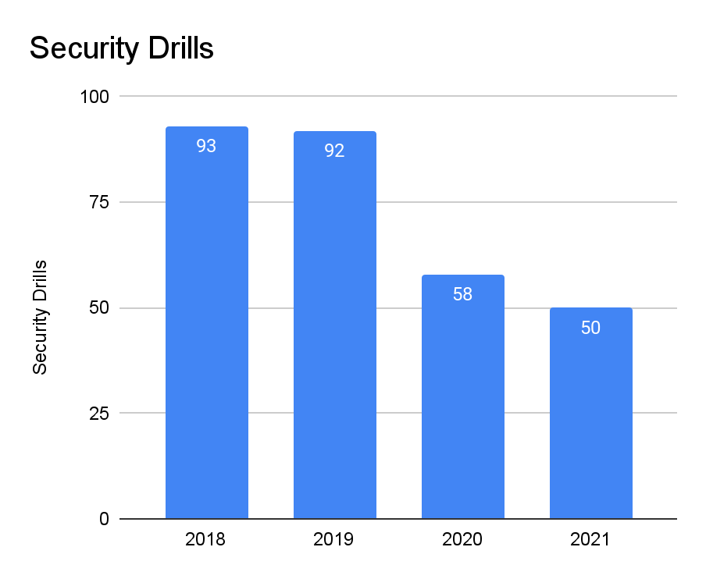
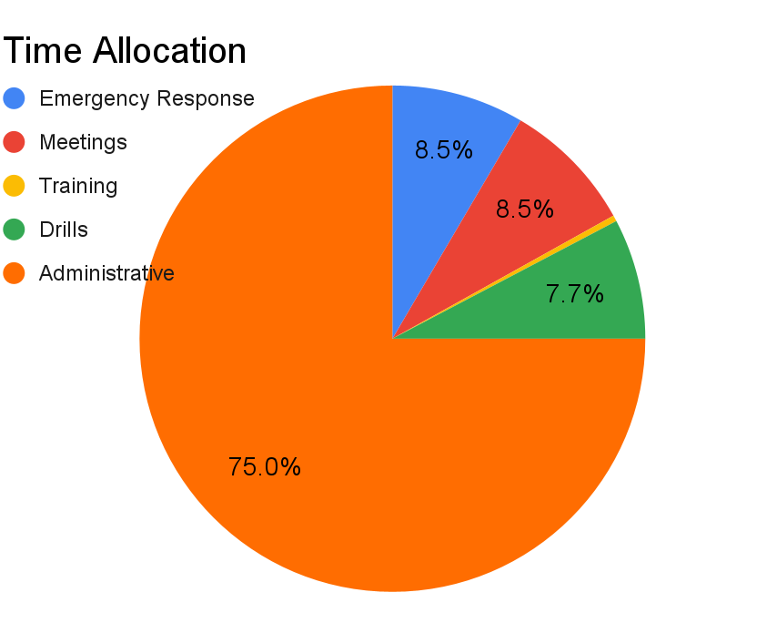
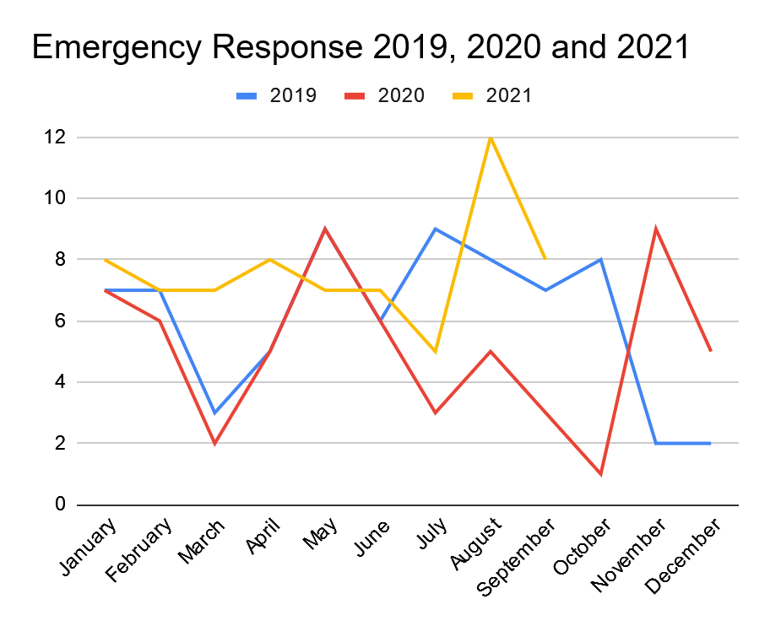
Office of Emergency Management
Ensure NIMS Compliance
Apply for EMA Grant
Drill with Schools and Businesses
Update Emergency Operations Plan and submit to State
Day Camp Training Drills
Training for Township Employees
Full Scale Drill
Training for OEM Members
COVID-19 Testing
EMA grant application submitted
Emergency Operations Plan updated and submitted to the State. Approved by State.
50 Security Drills completed with Schools
Completed Medical Countermeasures: Point of Dispensing Planning and Response Training
Tested 56 Employees for COVID-19
COOP Drill Completed
Assisted Health Department with COVID-19 Vaccination Clinics
Completed 2 Drills at Township Day Camps
Active Shooter Drill
CPR Training for Employees
Drill with Fire/EMS
Response Plans for Township Events
Establish PODs for COVID-19 Vaccine Clinics
Continue COVID-19 Testing
Working with FEMA regarding damage to public infrastructure from Tropical Storm Ida
Working with residents for mitigation efforts for homes damaged by Tropical Storm Ida

Slide 12
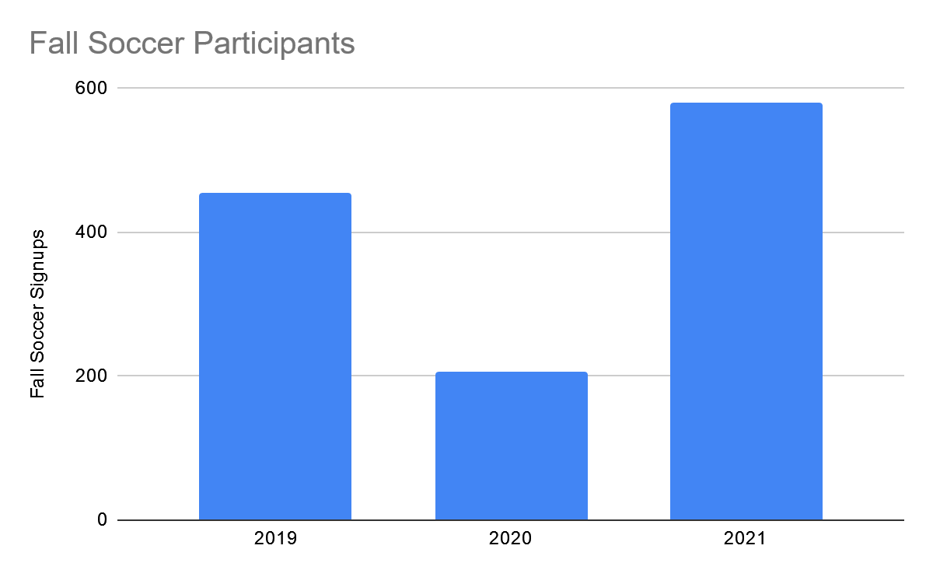
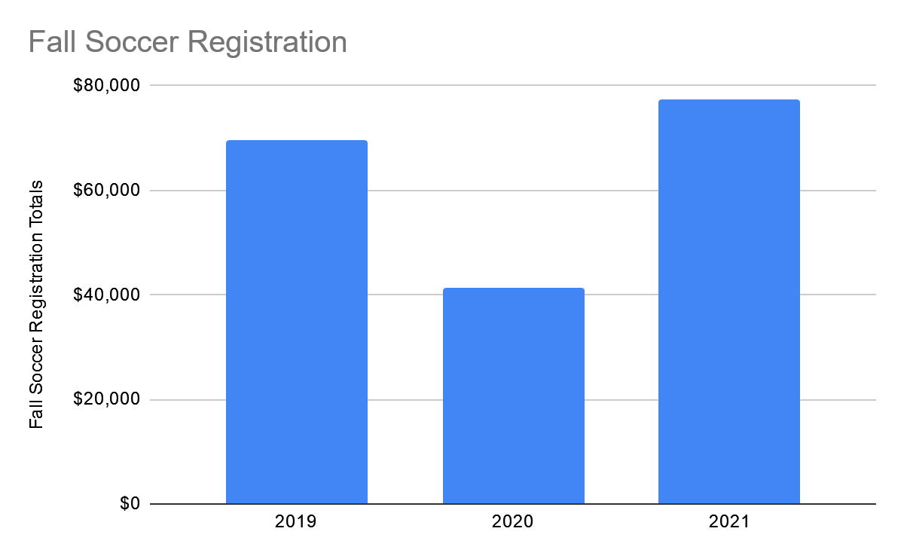
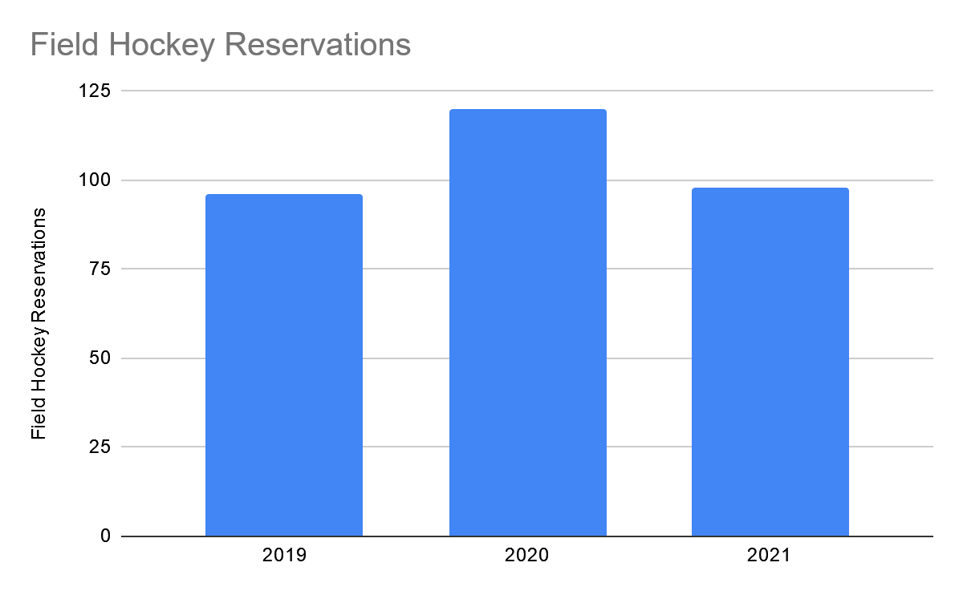
Parks & Recreation
581
$77,255
120
$69,650
455
96
98
$41,250
206
Worked in conjunction with Boy Scouts to install a sand volleyball court at Willow Complex.
Removal of dead ash trees at Ann Van & South Willow Complex.
Connected the AVM access road and P-Loop as an expanded trail.
Bird houses installed along the walking trails at Merdinger Trail.
Wrapped up the first full years worth of “Movie In The Park” which finished with 4 total showings for the year.
Offered a Go-Green Toy Swap allowing residents to recycle old, fair condition toys to new families.
Offered the annual Halloween costume exchange.
Renovation of Singley softball infields after Hurricane Ida.
Initial launch of E-Sports leagues to residents in Hillsborough.
New partnership between Royce Brook Golf Club & Hillsborough Township leading to adult & youth golf clinic offerings.
New partnership with NJ Sports Assigning Bureau to provide high quality softball officials.
DC Skate team hosted a mental health awareness event at Ann Van Skatepark.
Willow Basketball Court & Flagg Way tennis will both have patch work done prior to year end.
Complete renovation of the dual tennis courts at Woodfield Park, which are soon to include both tennis and pickleball.
Additional dog waste stations being installed at Woodfield Park.
New “Movie & Pajama Drive Night” being offered here in Hillsborough on Friday, Dec. 10th.
Planning underway for the “Home for the Holiday’s Light Celebration,” where residents light up their holidays during the holiday season.
Framework put in place for the snow decorating contest as well the start to next year's Valentines Day Luminaries project.

Slide 13
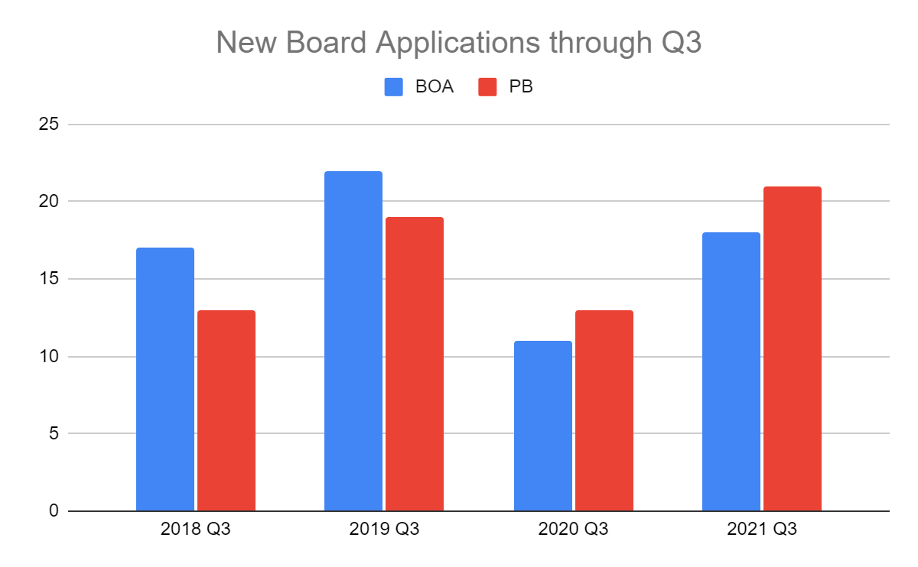
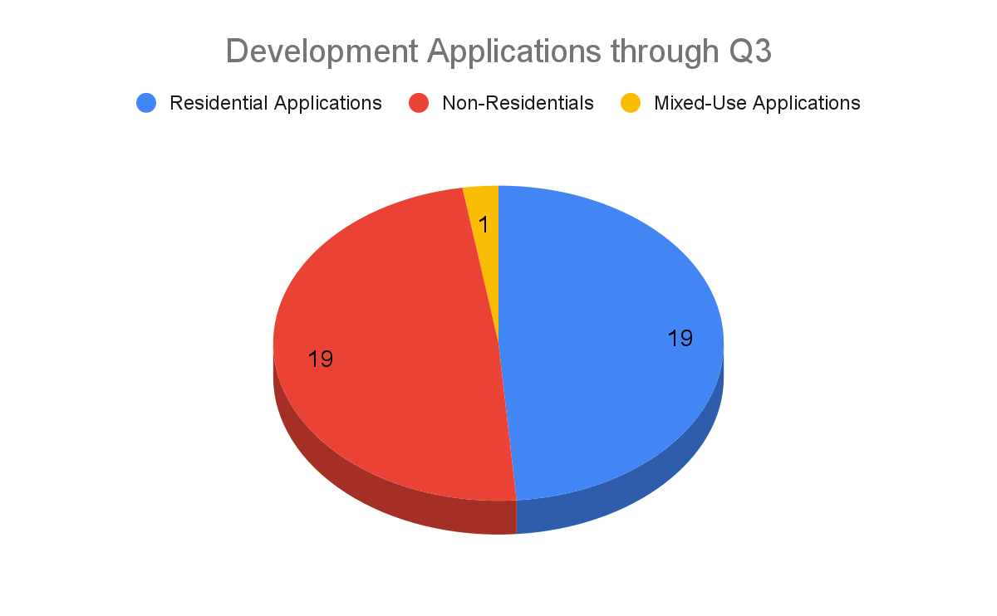
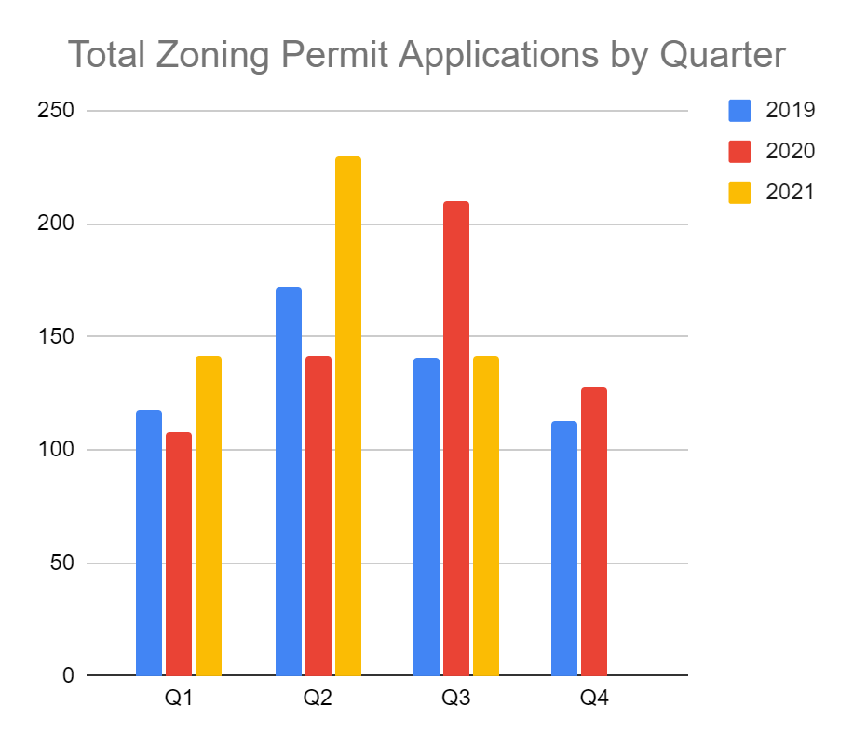
Planning & Zoning
Aff. Hsg. Element & Fair Share Plan (PB 11/4).
Affirm. Mktg Plan & Rehab Manual (TC 12/14).
Final AH compliance hearing w/Court (12/16)
Capital Project Request invitations sent out.
VDVH Phase 4. (Nov. bid)
Coordinate Sherman Phase 2.
Major Board applications:
Angras subdivision (10/28).
JSM/Cost Cutters site plan (12/9).
Harvard Way warehouse site plan (11/18).
Enclave @ Royce Brook subdivision(12/2).
M&M Glen Gery subdivision - east and west.
Amwell Road warehouse site plan.
Nassau Dog Day Care site plan.
Two new staff hired - ZO & AP/GIS
Zoning maps updated and posted.
Draft flood/road closure map completed.
Developed new format for capital requests.
Major Board Approvals:
Campus Assoc. AH site plan.
Green Care Farms dementia facility.
Moe’s drive-through.
Finalize affordable housing compliance.
Accept VDVH Phase 4 bids in November.
Finalize/summarize capital budget requests for TC.
Initiate rezoning studies.
Prepare Board/Commission annual reports.
Prepare for reorg meetings.
Develop VDVH Phase 5 renovation plan.
Possible VDVH grant application.
Work with County Planning on resiliency plan.
Adopt EV ordinance.

Slide 14
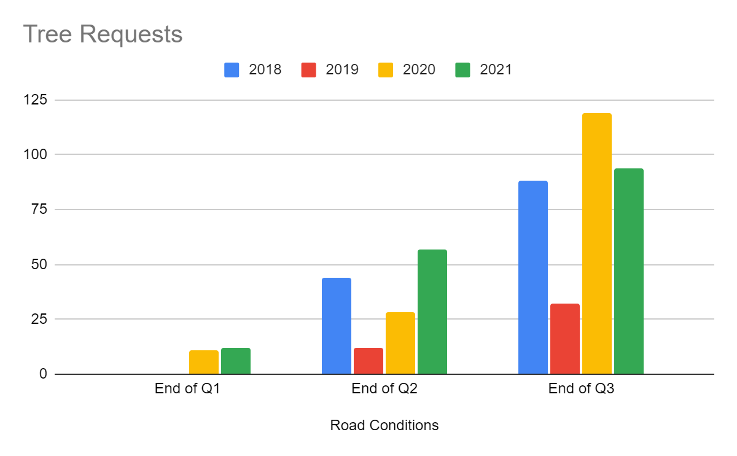
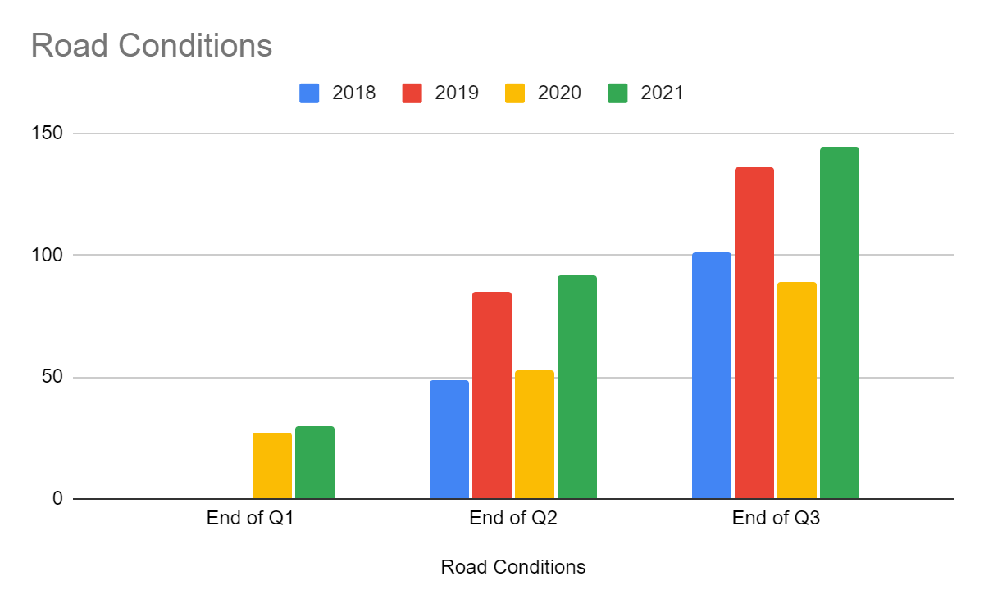
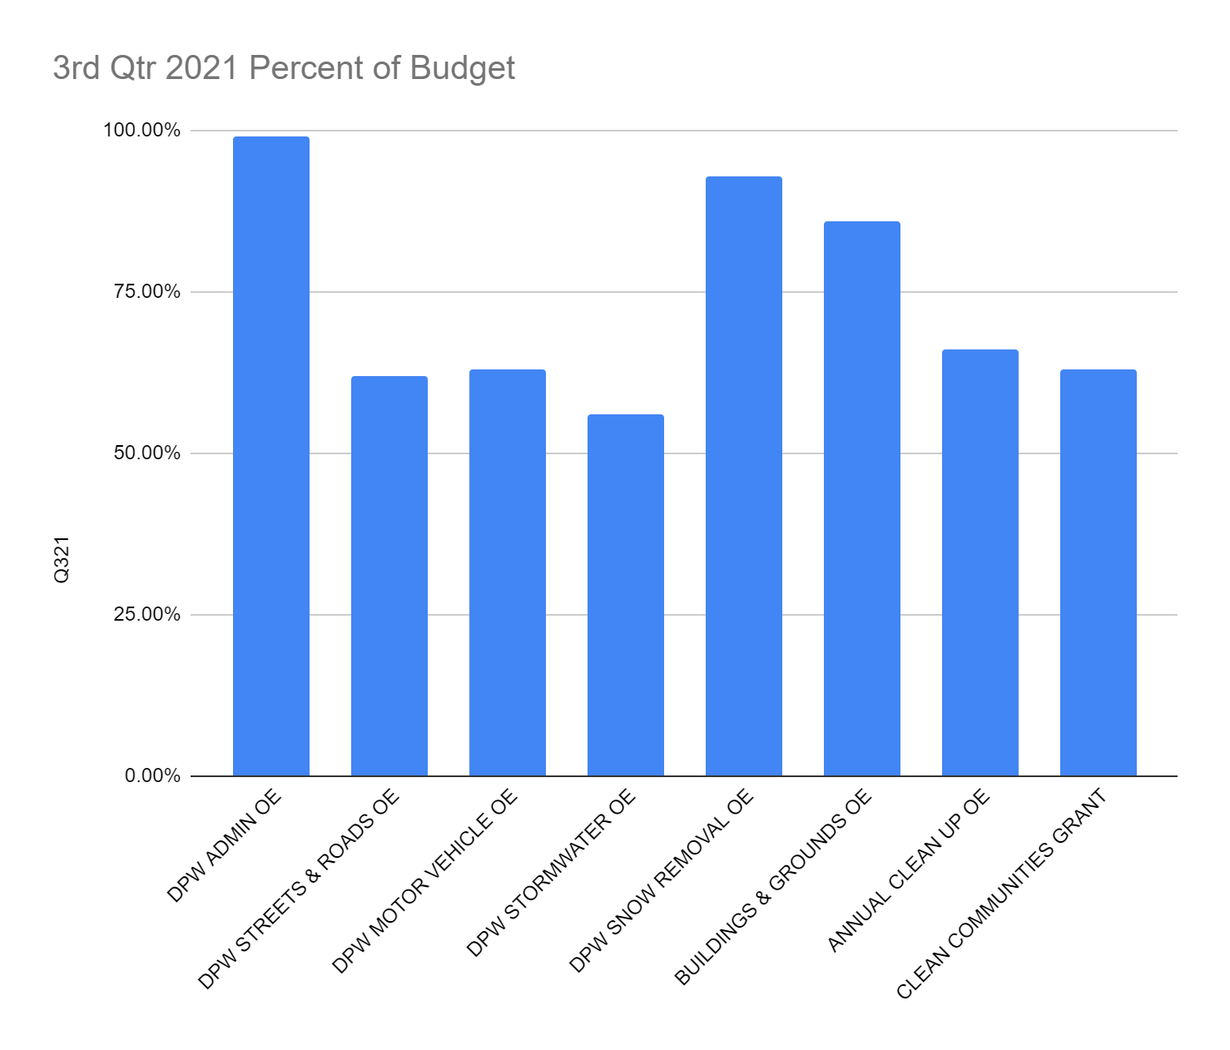
Public Works
Hurricane Ida Clean Up
Roadway Crack Sealing Program
Storm drain repairs/rebuilds
Commercial Mowing Contractor Program
Leaf Collection Program and Winter Operations Equipment Review/Repairs
Snow Plowing Contractor Contracts
Promoted Ron Lemieux from Mechanic to Foreman.
Promoted Greg Brandt from Foreman to Assistant Supervisor.
Created a Heavy Equipment Operator 1 opening.
Virtual Litter Clean Ups (ongoing)
7 Month, 14 Event Annual Clean Up Culminates October 30.
Clean Communities Event - Littercon on November 13
Create Board of Directors for Clean Communities Program
Road Maintenance Strategies 2022

Slide 15
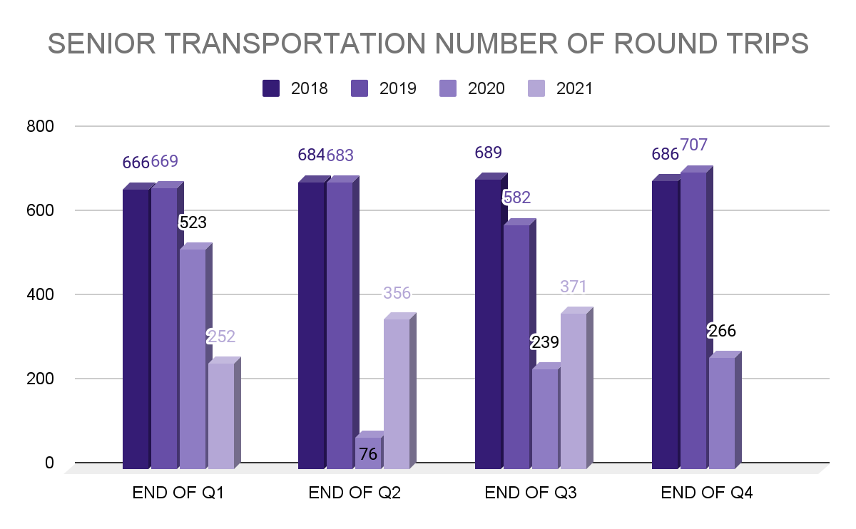
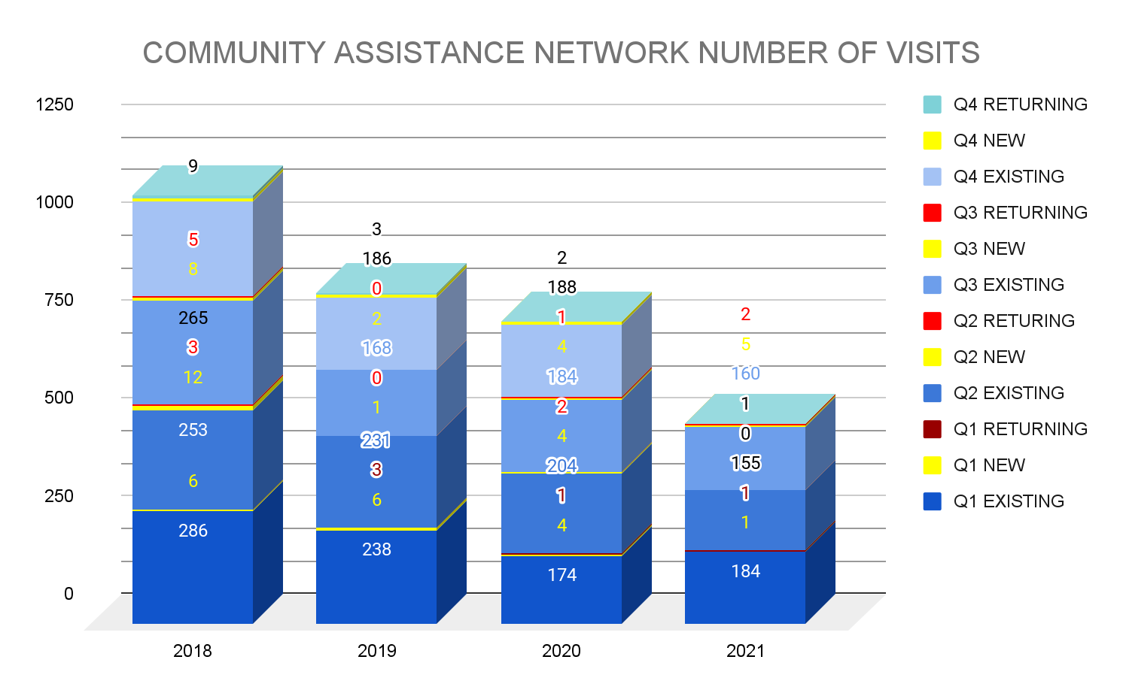
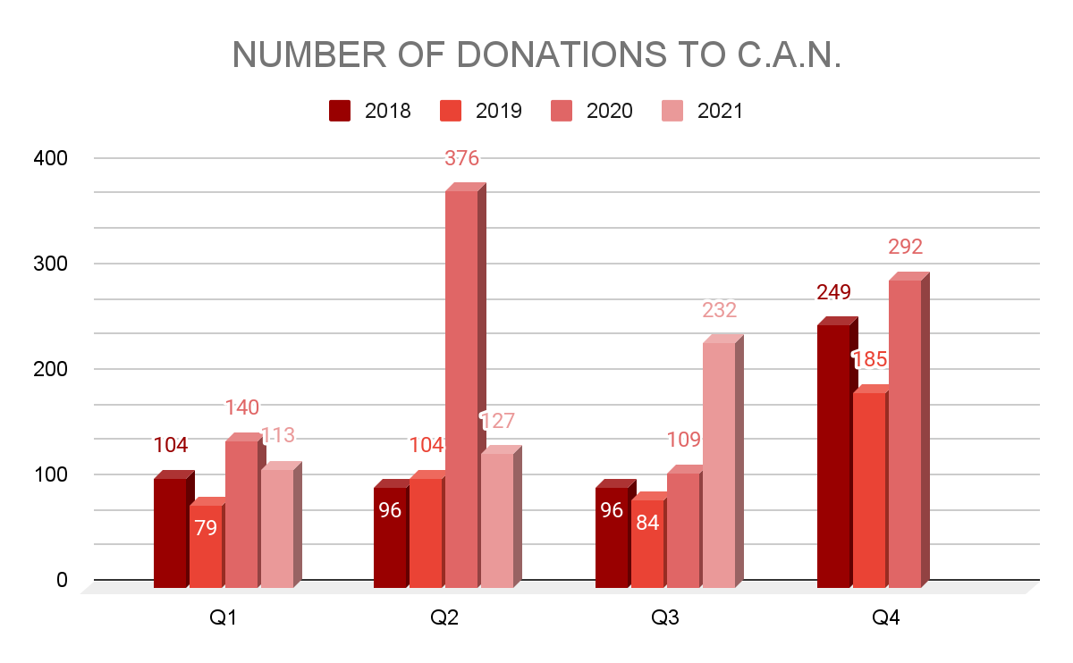
Social Services
Managing donations, organizing and rotating stock
Monthly Mass Feeding & Vulnerable populations meetings
Updating MPR room use policy and procedures
Senior Exercise Program
November 12th Food distribution
Boo Bash in partner with FootHIll acres Oct 27th
Working with Volunteer for cooking videos for web page
Holiday Program prep (Thanksgiving & Christmas)
Working w/Health Dept. Covid & Flu vaccines for seniors.
Mayors Wellness Campaign/Health/Rutgers Intern - Childhood obesity pamphlet.
Trex Community Plastic bag collection challenge, Part of Litter Did You Know campaign/PSE&G NJ Sust. grant
REACH Intern project of Flooding and Emerg Preparedness for seniors
Mass Feeding Drive thru event Nov 12th
Drive thru Health Fair Foothill Acres at Willow Road 7/15/21
Back to School, supply drive
Backpacks for Students distribution
Mass Food Distributions 9/30/21
Senior Dancers back to practices
Expanded Busing coverage to Princeton Medical Center and Hunterdon Medical Center
Trex Challenge completed information being submitted for park bench.
Employee Plastic Bag Challenge
Managing and distributing collected clothing/household/food items due to Hurricane Ida.
Providing resources and supplies to 165 families over a 17 day period.
New Bus on order - delayed
New Department SUV ordered - delayed
PBA Stuff the bus Food Drive Nov 20th
Increased information on web page
Boo Bash for seniors Oct 27th Ann Van Park
Changing over 1 of our senior exercise classes to an evening class for seniors who still work.
Increased education resources and virtual videos for the C.A.N. clients
Increase the number of outreach events for C.A.N.

Slide 16
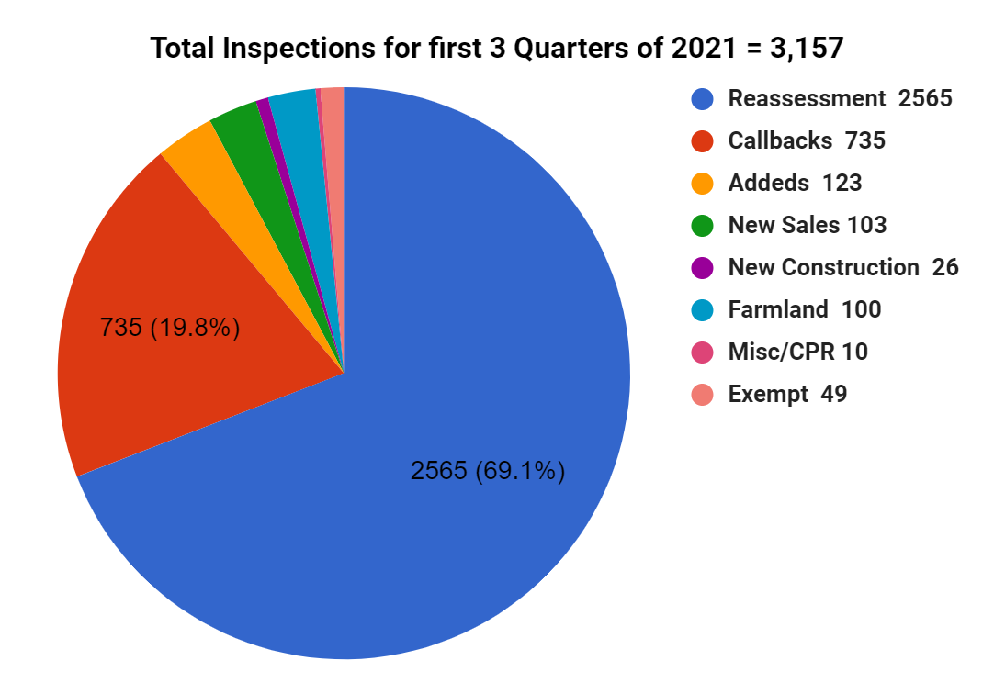
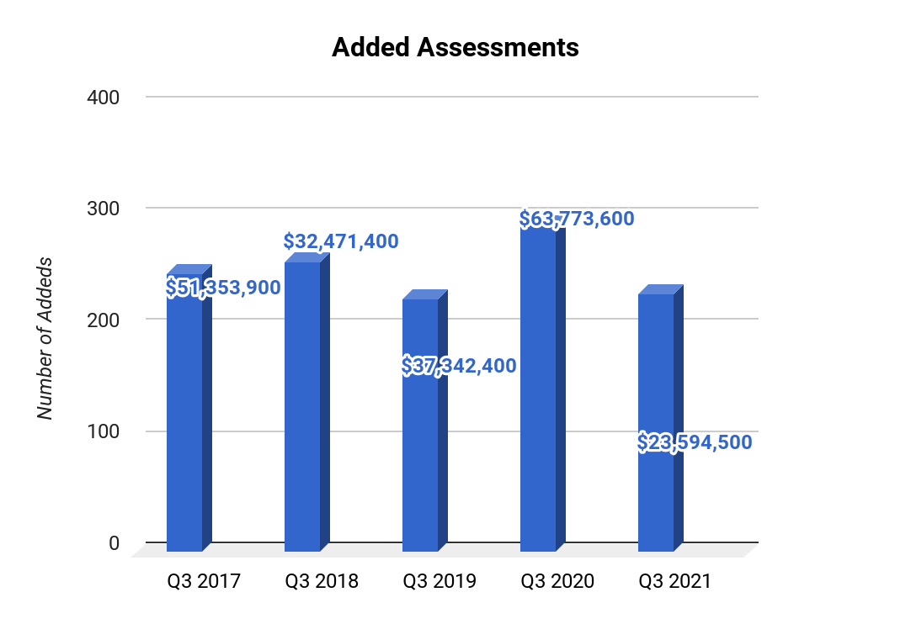
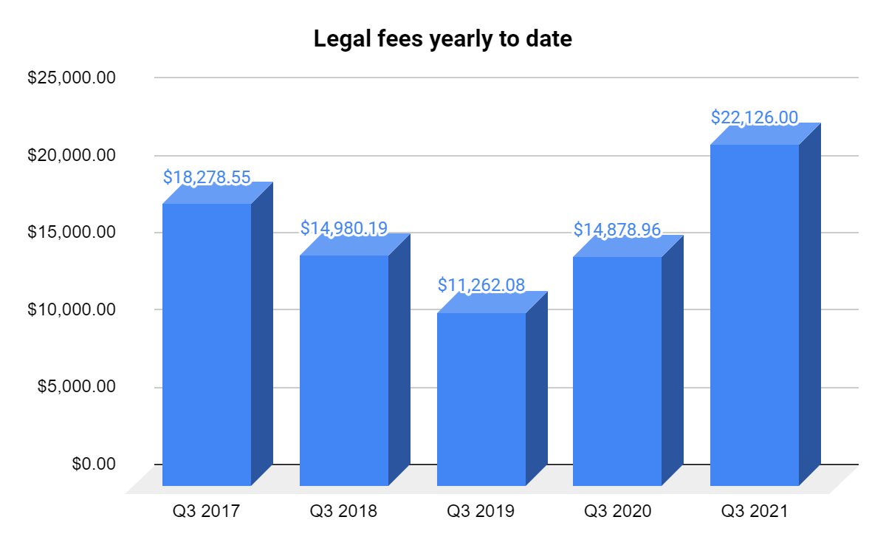
Assessor
Phase 3 (Research of market trends) of the reassessment is delayed to the new vendor
Reassessment inspections for 2022 have begun in October (total 4,260)
Assessor working on valuing properties impacted by IDA and the pandemic
Mailing reassessment information to areas that are to be inspected for the reassessment program
Ongoing collaboration with the new software vendor to incorporate different functions and reports needed
Updating all farmland property values due to increase in values as per Rutgers Cooperative
Staff had inspected 116 properties affected by IDA
Over 250 Addeds were inspected and calculated
for additional value and filed on October 1st
100 Farmland inspections were performed
254 Farmland applications were processed and reviewed
As of 10/26/21 - 918 deeds processed
Inspectors completed Rutgers PTA 1 course
53 Further Statements were created and mailed
Staff members were trained to use tablets during inspections replacing a hard copy of property record cards
Staff entered approximately 3,000 inspection sheets
Administrative Assistant will take Rutgers PTA 1 course in Spring 2022
Inspectors will take PTA 2 course in Spring 2022
Deeds received after 9/1/21 are reflecting stable sale prices without further substantial increases
New Somerset County Tax Board Administrator will be more hands on with the Assessors and plans to spend more time at the Assessor’s offices and in the field with each Assessor

Slide 17
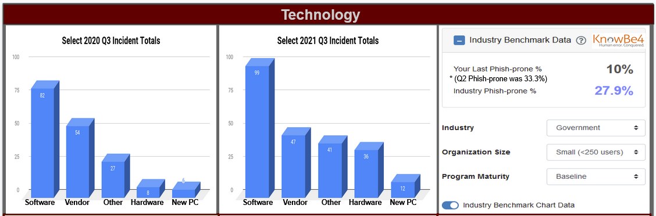

Slide 18

“THINGS GET DONE ONLY IF THE DATA WE
GATHER CAN INFORM AND INSPIRE THOSE
IN A POSITION TO MAKE A DIFFERENCE”
~ Michael J Schmoker ~

